Slide 1
Investigation of Plasmon-Polaritons and Phonon-Polaritons in Hexagonal
Boron Nitride / Metal Nanopattern Layered Devices
A Dissertation Defense in Partial Fulfillment of the Requirements for the Degree
Doctor of Philosophy
By Dermot Jim Thomas Heneghan
Under the Direction of William M. Dennis
Committee Members: Michael R. Geller, Heinz-Bernd Schüttler
November 3rd, 9:00 AM, Physics Building Conference Room,
Department of Physics and Astronomy

Slide 2
Acknowledgements
W. M. Dennis
PhD Advisor
Department of Physics and Astronomy
University of Georgia
The Abate Group
Useful discussions
Department of Physics and Astronomy
University of Georgia
Shan-Ho Tsai
Technical expertise with high performance computing
Georgia Advanced Research Computing Center
University of Georgia
Michael R. Geller
Committee member
Department of Physics and Astronomy
University of Georgia
Heinz-Bernd Schüttler
Committee member
Department of Physics and Astronomy
University of Georgia

Slide 3
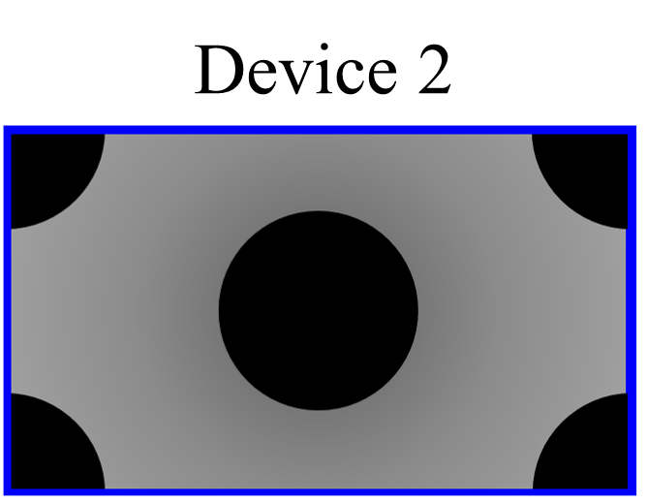


Outline
Introduction
Motivation
Background
FDTD Methodology
Combined Plasmon-Polariton Phonon-Polariton System
Materials Considerations
Parallelization
First Device Results
Far-field analysis
Near-field analysis
Second Device Comparison
Near-field and far-field
Hexagonal pattern holes in Ag
Third Device Comparison
Near-field and far-field
Perfect Plasmonic Absorber
Conclusions

Slide 4
Hexagonal Boron Nitride (hBN)
Initial interest in hBN was due its similar crystal structure and proven compatibility with graphene
Further interest arose due to the unique properties of hBN’s refractive index, which enable a range applications including
Sensing in the UV and IR spectra
Engineering point defects to obtain room temperature single photon emission
Realizing UV emission devices
As a component in heterostructure devices to enable subwavelength confinement
Infrared
nanophotonics
Single-photon emitters
Van der Waals heterostructures
Ultraviolet emitters
(Caldwell et al., 2019)

Slide 5
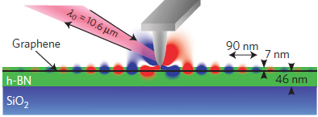
Plasmon-Polaritons and Phonon-Polaritons
e⁻
e⁻
e⁻
e⁻
e⁻
e⁻
e⁻
A polariton is a quasiparticle resulting from strong coupling of electromagnetic waves with an electric or magnetic dipole-carrying excitation.
A plasmon-polariton is a motion of the electron charge (plasmon) accompanied by a coupling photon
A phonon-polariton is a lattice vibration (optical phonon) coupling with an infrared photon
A localized surface plasmon is the result of a plasmon confined to a structure/feature smaller than the exciting wavelength
Au
Au
Au
Au
Au
Au
Au
N
B
N
B
N
B
N
B
N
B
N
Woessner et. al., 2021

Slide 6
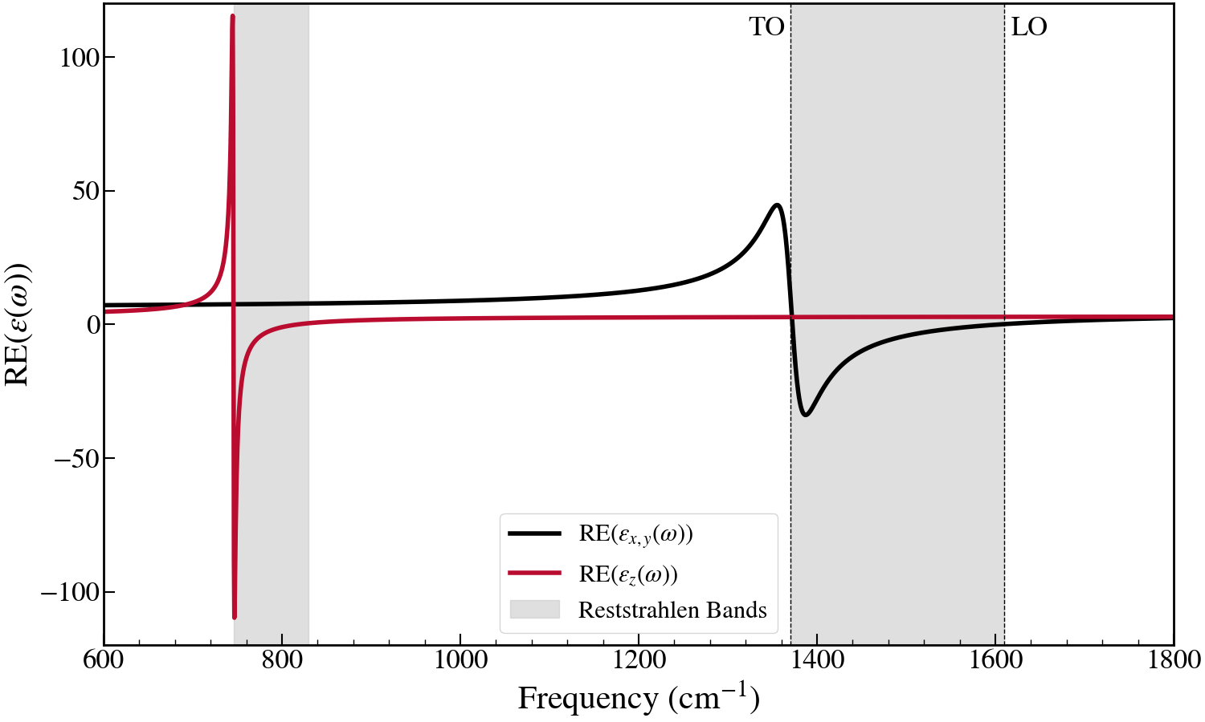
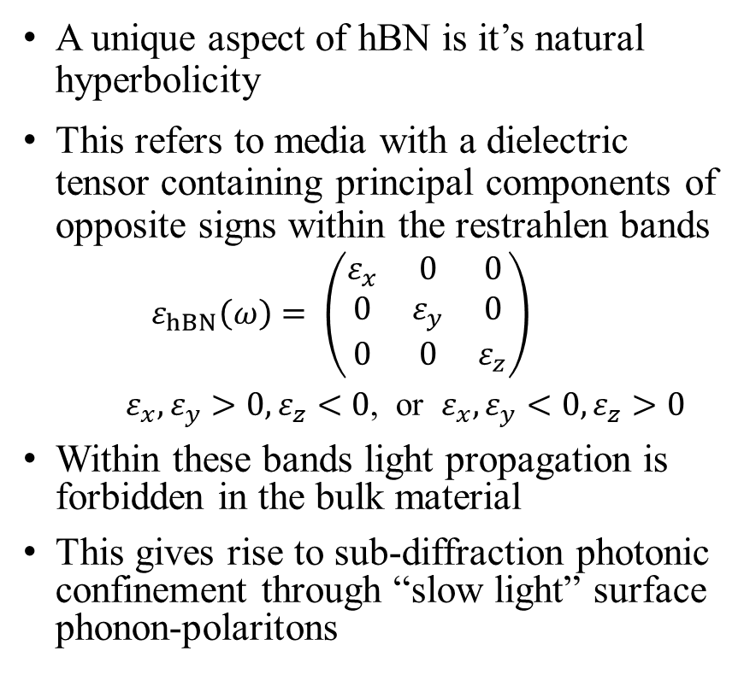
Hyperbolicity in hBN
A unique aspect of hBN is it’s natural hyperbolicity
This refers to media with a dielectric tensor containing principal components of opposite signs within the restrahlen bands
$$ε_{hBN}\left(ω\right)= \left(\begin{matrix}ε_{x} & 0 & 0 \\ 0 & ε_{y} & 0 \\ 0 & 0 & ε_{z}\end{matrix}\right)$$
$ε_{x},ε_{y}>0,ε_{z}<0$, or $ε_{x},ε_{y}<0,ε_{z}>0$
Within these bands light propagation is forbidden in the bulk material
This gives rise to sub-diffraction photonic confinement through “slow light” surface phonon-polaritons
Fig. 1 Derived real parts of the permittivity tensor components of hBN
Fig. 2 Bylinkin et al., 2021

Slide 7
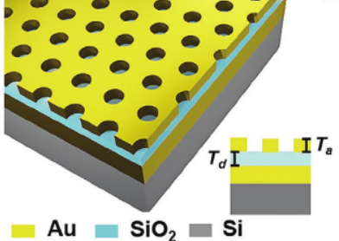
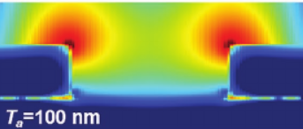
Plasmonic Metamaterials
Periodic structures which can result in optical properties not otherwise found in nature
These devices can be produced by layering nanoscale metal gratings over suitable substrates
By altering the device parameters, they have been shown to be highly tunable
Ultrahigh absorption (~99%) in the visible and near infrared region has been reported
Yang et.al., 2021

Slide 8
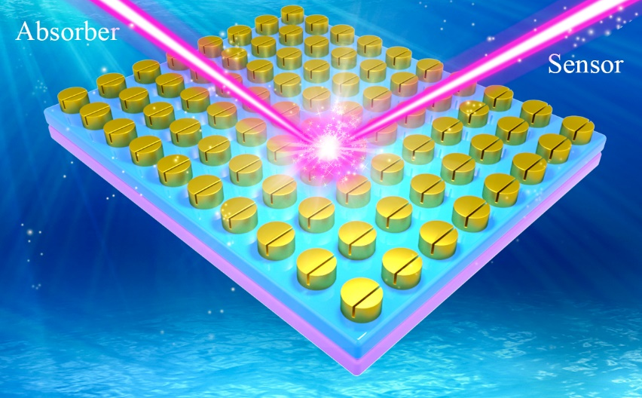
Plasmons and Polaritons
Localized Surface Plasmons
Tunable Resonant Frequency
Field Enhancement
hBN Slab Phonon Polaritons
Spatially Confined
Slow velocity
Metamaterial Devices

Slide 9
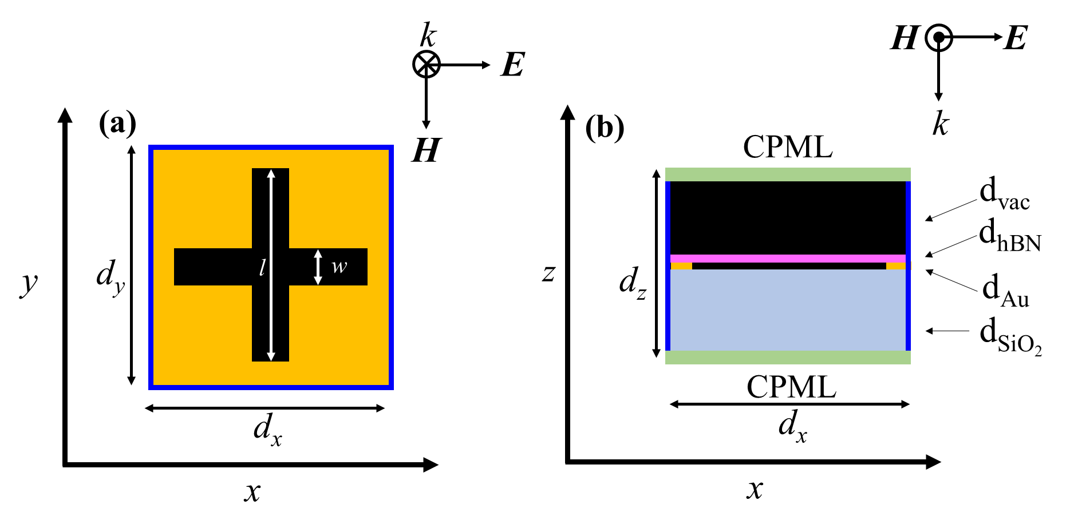
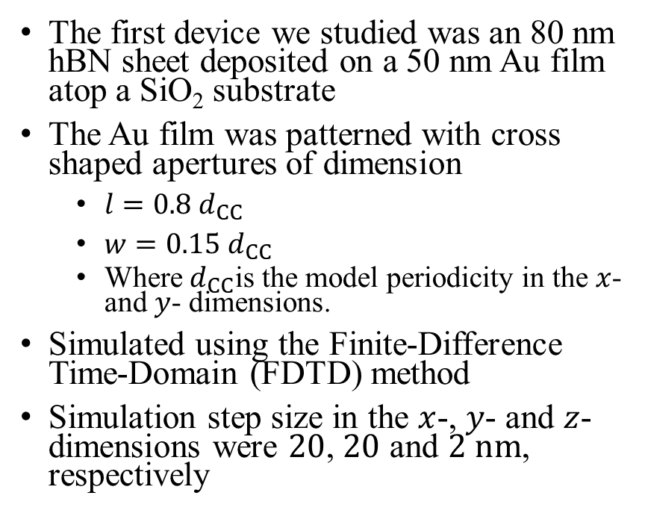
First Device Studied
The first device we studied was an 80 nm hBN sheet deposited on a 50 nm Au film atop a SiO₂ substrate
The Au film was patterned with cross shaped apertures of dimension
$l=0.8 d_{CC}$
$w=0.15{ d}_{CC}$
Where${ d}_{CC}$is the model periodicity in the $x$- and $y$- dimensions.
Simulated using the Finite-Difference Time-Domain (FDTD) method
Simulation step size in the $x$-, $y$- and $z$- dimensions were $20$, $20$ and $2 nm$, respectively

Slide 10
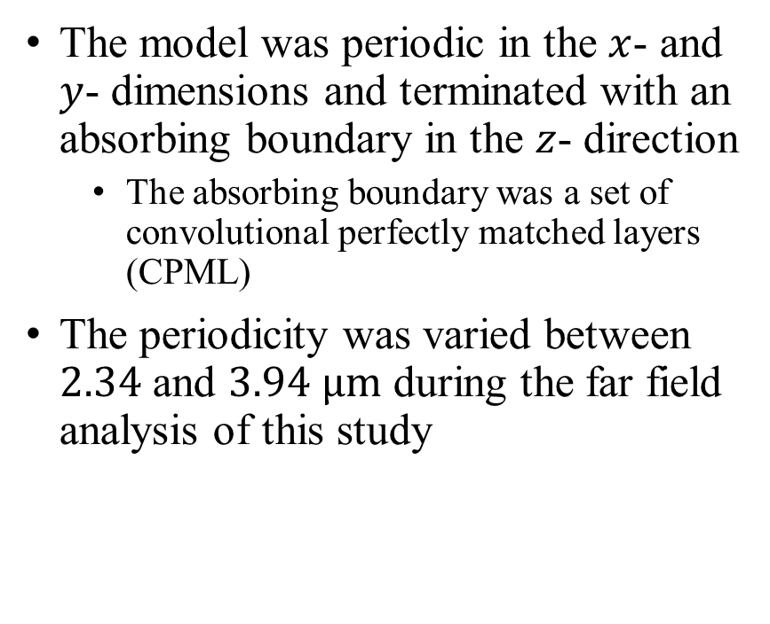
First Device Studied
The model was periodic in the $x$- and $y$- dimensions and terminated with an absorbing boundary in the $z$- direction
The absorbing boundary was a set of convolutional perfectly matched layers (CPML)
The periodicity was varied between $2.34$ and $3.94 μm$ during the far field analysis of this study

Slide 11
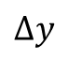

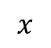
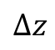

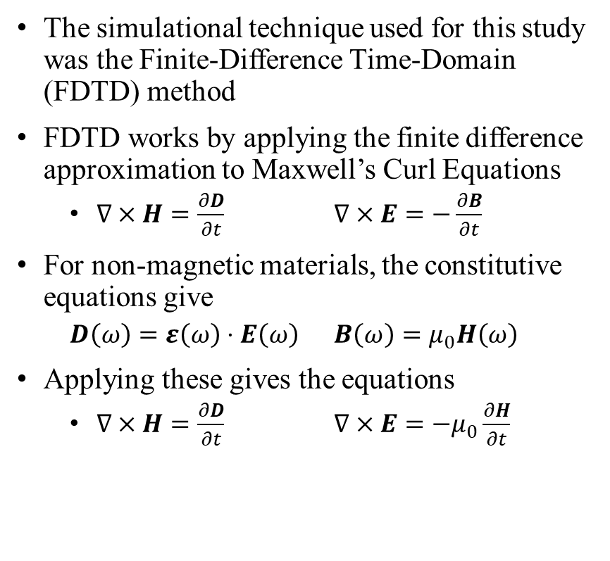
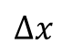

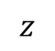

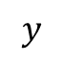


Finite-Difference Time-Domain
$$z$$
The simulational technique used for this study was the Finite-Difference Time-Domain (FDTD) method
FDTD works by applying the finite difference approximation to Maxwell’s Curl Equations
$∇×H=\frac{∂D}{∂t}$ $∇×E=−\frac{∂B}{∂t}$
For non-magnetic materials, the constitutive equations give
$D\left(ω\right)=ε\left(ω\right)⋅E\left(ω\right)$ $B\left(ω\right)=μ_{0}H\left(ω\right)$
Applying these gives the equations
$∇×H=\frac{∂D}{∂t}$ $∇×E=−μ_{0}\frac{∂H}{∂t}$
$$H_{x}$$
$$Δz$$
$$H_{y}$$
$$E_{z}$$
$$E_{y}$$
$$y$$
$$E_{x}$$
$$H_{z}$$
$$Δy$$
$$Δx$$
$$x$$
Fig. 1 Yee Cell

Slide 12
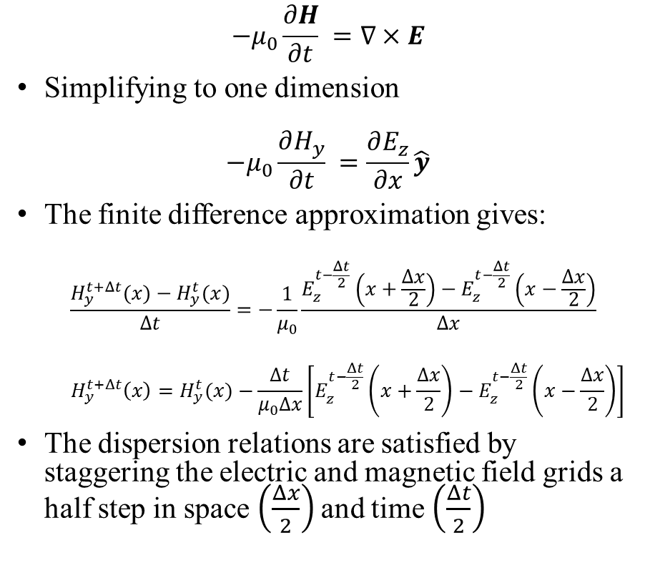
Finite-Difference Time-Domain
$$z$$
$$−μ_{0}\frac{∂H}{∂t} =∇×E$$
Simplifying to one dimension
$$−μ_{0}\frac{∂H_{y}}{∂t} =\frac{∂E_{z}}{∂x}\hat{y}$$
The finite difference approximation gives:
$$\frac{H_{y}^{t+Δt}(x)−H_{y}^{t}(x)}{Δt}=−\frac{1}{μ_{0}}\frac{E_{z}^{t−\frac{Δt}{2}}\left(x+\frac{Δx}{2}\right)−E_{z}^{t−\frac{Δt}{2}}\left(x−\frac{Δx}{2}\right)}{Δx}$$
$$H_{y}^{t+Δt}\left(x\right)=H_{y}^{t}(x)−\frac{Δt}{μ_{0}Δx}\left[E_{z}^{t−\frac{Δt}{2}}\left(x+\frac{Δx}{2}\right)−E_{z}^{t−\frac{Δt}{2}}\left(x−\frac{Δx}{2}\right)\right]$$
The dispersion relations are satisfied by staggering the electric and magnetic field grids a half step in space $\left(\frac{Δx}{2}\right)$and time $\left(\frac{Δt}{2}\right)$
$$H_{x}$$
$$Δz$$
$$H_{y}$$
$$E_{z}$$
$$E_{y}$$
$$y$$
$$E_{x}$$
$$H_{z}$$
$$Δy$$
$$Δx$$
$$x$$
Fig. 1 Yee Cell

Slide 13
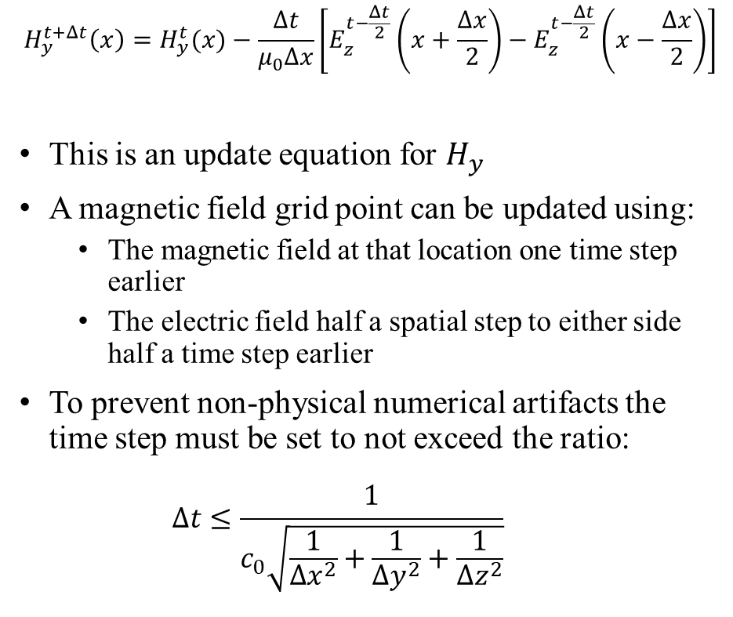
Finite-Difference Time-Domain
$$z$$
$$H_{y}^{t+Δt}\left(x\right)=H_{y}^{t}(x)−\frac{Δt}{μ_{0}Δx}\left[E_{z}^{t−\frac{Δt}{2}}\left(x+\frac{Δx}{2}\right)−E_{z}^{t−\frac{Δt}{2}}\left(x−\frac{Δx}{2}\right)\right]$$
This is an update equation for $H_{y}$
A magnetic field grid point can be updated using:
The magnetic field at that location one time step earlier
The electric field half a spatial step to either side half a time step earlier
To prevent non-physical numerical artifacts the time step must be set to not exceed the ratio:
$$Δt≤\frac{1}{c_{0}\sqrt{\frac{1}{Δx^{2}}+\frac{1}{Δy^{2}}+\frac{1}{Δz^{2}}}}$$
$$H_{x}$$
$$Δz$$
$$H_{y}$$
$$E_{z}$$
$$E_{y}$$
$$y$$
$$E_{x}$$
$$H_{z}$$
$$Δy$$
$$Δx$$
$$x$$
Fig. 1 Yee Cell

Slide 14
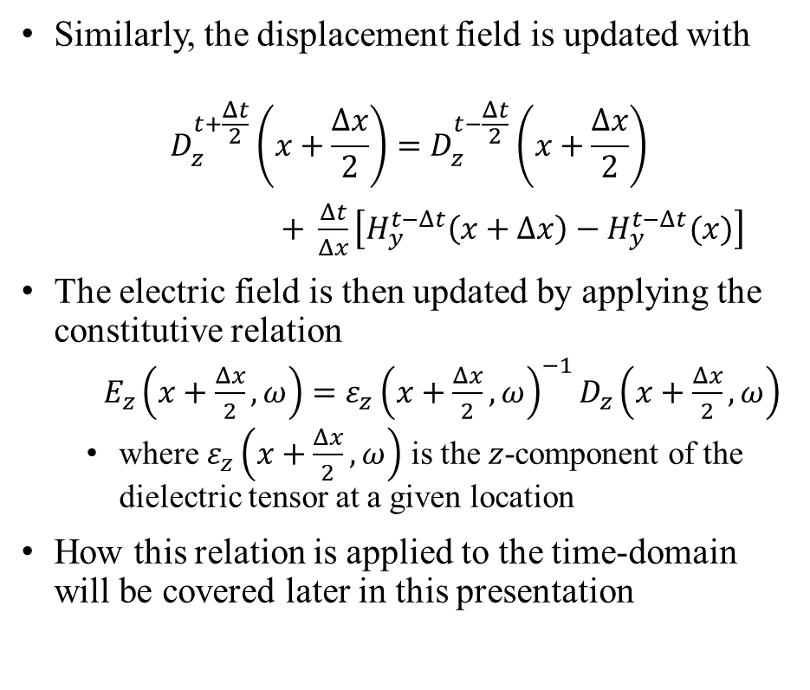
Finite-Difference Time-Domain
$$z$$
Similarly, the displacement field is updated with
$$D_{z}^{t+\frac{Δt}{2}}\left(x+\frac{Δx}{2}\right)=D_{z}^{t−\frac{Δt}{2}}\left(x+\frac{Δx}{2}\right)$$
$+ \frac{Δt}{Δx}\left[H_{y}^{t−Δt}\left(x+Δx\right)−H_{y}^{t−Δt}(x)\right]$
The electric field is then updated by applying the constitutive relation
$E_{z}\left(x+\frac{Δx}{2},ω\right)=ε_{z}{\left(x+\frac{Δx}{2},ω\right)}^{−1}D_{z}\left(x+\frac{Δx}{2},ω\right)$
where $ε_{z}\left(x+\frac{Δx}{2},ω\right)$ is the $z$-component of the dielectric tensor at a given location
How this relation is applied to the time-domain will be covered later in this presentation
$$H_{x}$$
$$Δz$$
$$H_{y}$$
$$E_{z}$$
$$E_{y}$$
$$y$$
$$E_{x}$$
$$H_{z}$$
$$Δy$$
$$Δx$$
$$x$$
Fig. 1 Yee Cell

Slide 15
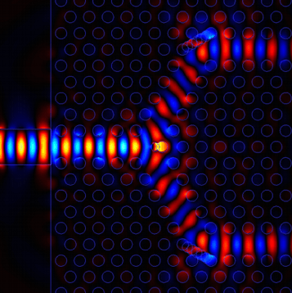
Benefits of FDTD
Excellent for large scale simulations
Scales linearly where many methods scale exponentially
Can simulate fine detail structure
Time domain aspect enables broad band simulation
Suitable for parallelization
Applicable over a wide range wavelength scales
Nano scale metamaterials interacting with IR wavelengths
Radar scale wavelengths interacting with jets
FDTD simulation of a photonic crystal Y-junction,
Photon Design, 2021

Slide 16
Outline
Introduction
Motivation
Background
FDTD Methodology
Combined Plasmon-Polariton Phonon-Polariton System
Materials Considerations
Parallelization
First Device Results
Far-field analysis
Near-field analysis
Second Device Comparison
Near-field and far-field
Hexagonal pattern holes in Ag
Third Device Comparison
Near-field and far-field
Perfect Plasmonic Absorber
Conclusions

Slide 17
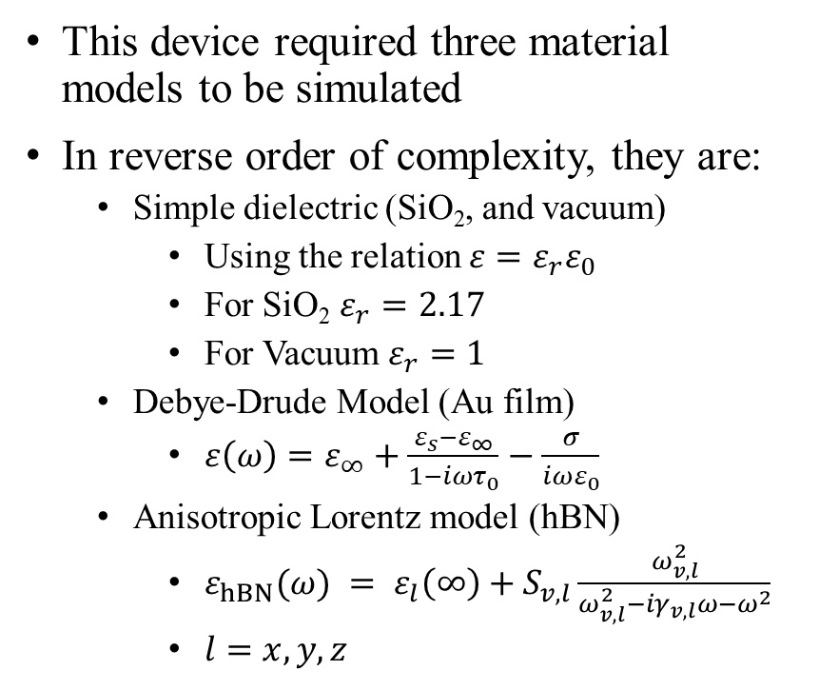
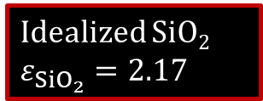
Simulating Materials - SiO₂, Au, hBN
This device required three material models to be simulated
In reverse order of complexity, they are:
Simple dielectric (SiO₂, and vacuum)
Using the relation $ε=ε_{r}ε_{0}$
For SiO₂ $ε_{r}=2.17$
For Vacuum $ε_{r}=1$
Debye-Drude Model (Au film)
$ε\left(ω\right)=ε_{∞}+\frac{ε_{s}−ε_{∞}}{1−iωτ_{0}}−\frac{σ}{iωε_{0}}$
Anisotropic Lorentz model (hBN)
$ε_{hBN}(ω) = ε_{l}\left(∞\right)+S_{v,l}\frac{ω_{v,l}^{2}}{ω_{v,l}^{2}−iγ_{v,l}ω−ω^{2}}$
$l=x,y,z$
Idealized SiO₂ $ε_{{SiO}_{2}}=2.17$

Slide 18
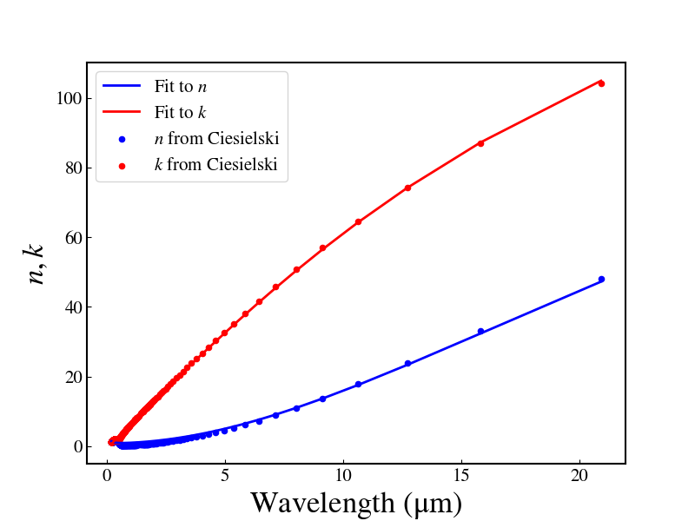
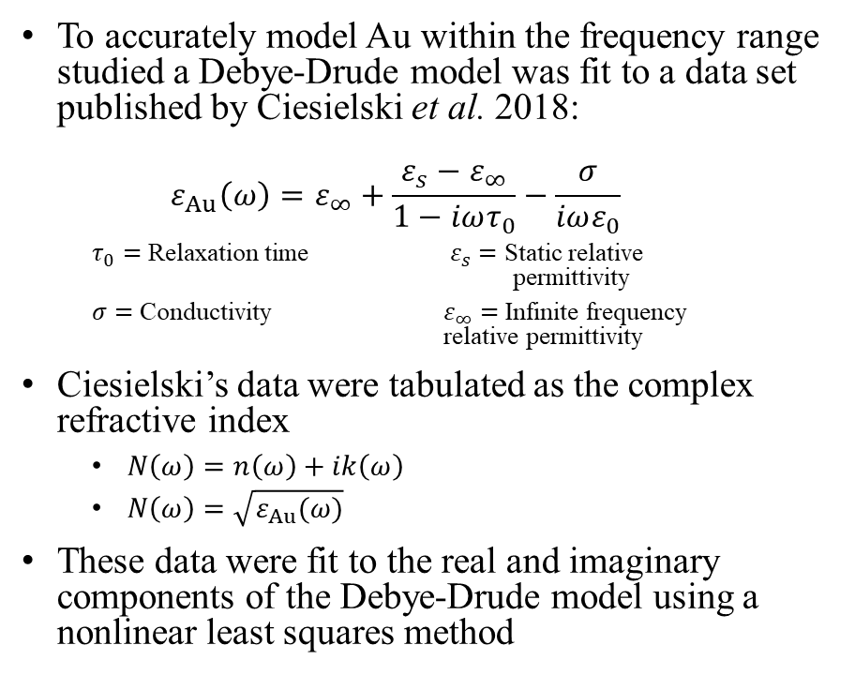
Simulating Materials - Au
To accurately model Au within the frequency range studied a Debye-Drude model was fit to a data set published by Ciesielski et al. 2018:
$$ε_{Au}\left(ω\right)=ε_{∞}+\frac{ε_{s}−ε_{∞}}{1−iωτ_{0}}−\frac{σ}{iωε_{0}}$$
$τ_{0}=$ Relaxation time $ε_{s}=$ Static relative permittivity
$σ=$ Conductivity $ε_{∞}=$ Infinite frequency relative permittivity
Ciesielski’s data were tabulated as the complex refractive index
$N\left(ω\right)=n\left(ω\right)+ik\left(ω\right)$
$N\left(ω\right)=$ $\sqrt{ε_{Au}(ω)}$
These data were fit to the real and imaginary components of the Debye-Drude model using a nonlinear least squares method

Slide 19
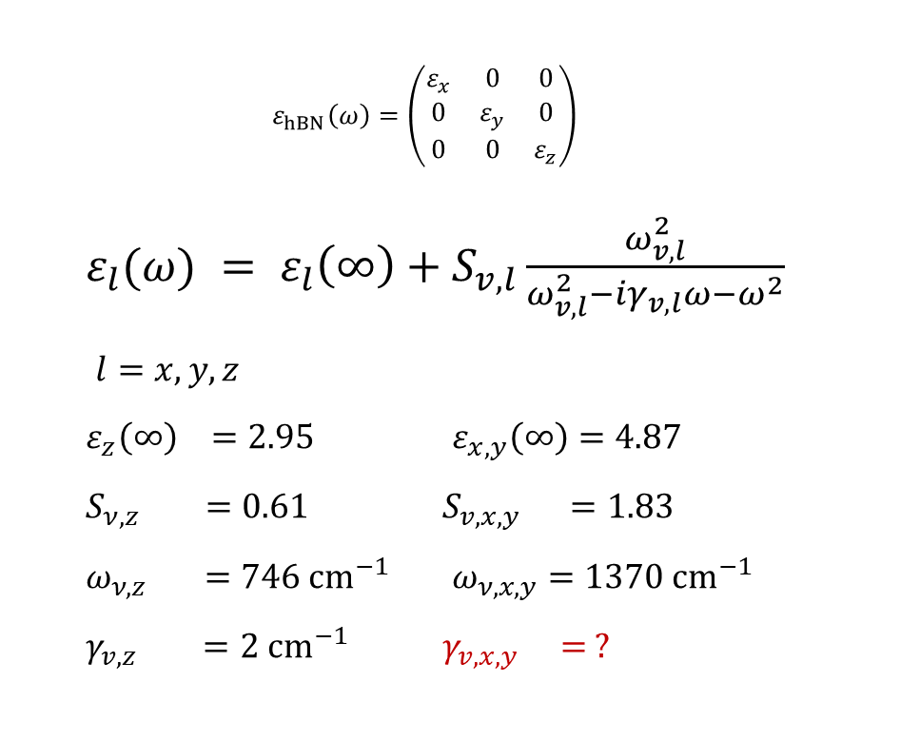
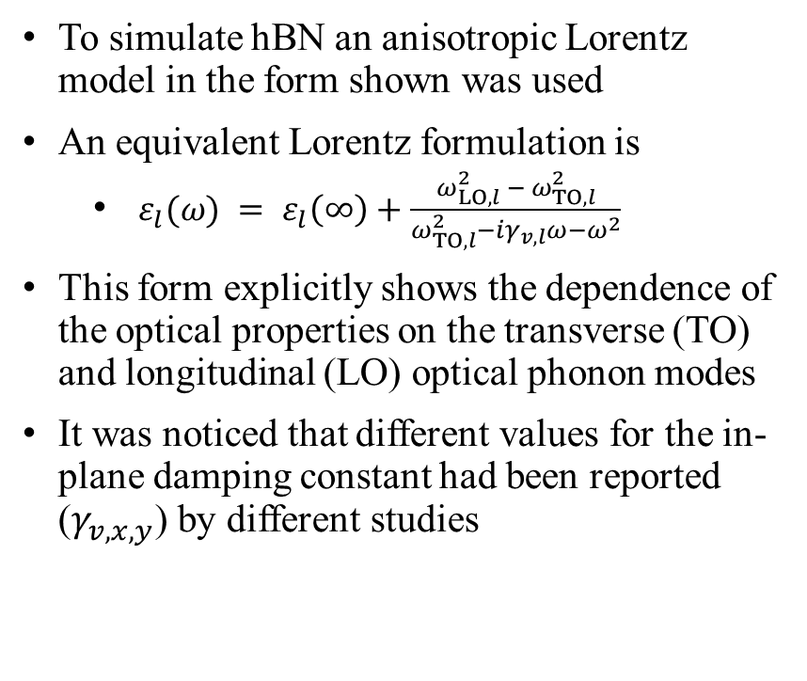
Simulating Materials - hBN - I
$$ε_{hBN}\left(ω\right)=\left(\begin{matrix}ε_{x} & 0 & 0 \\ 0 & ε_{y} & 0 \\ 0 & 0 & ε_{z}\end{matrix}\right)$$
$ε_{l}(ω) = ε_{l}\left(∞\right)+S_{v,l}\frac{ω_{v,l}^{2}}{ω_{v,l}^{2}−iγ_{v,l}ω−ω^{2}}$
$l=x,y,z$
$ε_{z}\left(∞\right) =2.95$ $ε_{x,y}\left(∞\right)=4.87$
$S_{ν,z} =0.61$ $S_{v,x,y} =1.83$
$ω_{ν,z} =746 cm^{−1}$ $ω_{ν,x,y}=1370 cm^{−1}$
$γ_{v,z} =2 cm^{−1}$ $γ_{v,x,y} = ?$
To simulate hBN an anisotropic Lorentz model in the form shown was used
An equivalent Lorentz formulation is
$ε_{l}(ω) = ε_{l}\left(∞\right)+\frac{ω_{LO,l}^{2} − ω_{TO,l}^{2}}{ω_{TO,l}^{2}−iγ_{v,l}ω−ω^{2}}$
This form explicitly shows the dependence of the optical properties on the transverse (TO) and longitudinal (LO) optical phonon modes
It was noticed that different values for the in-plane damping constant had been reported ($γ_{v,x,y}$) by different studies

Slide 20
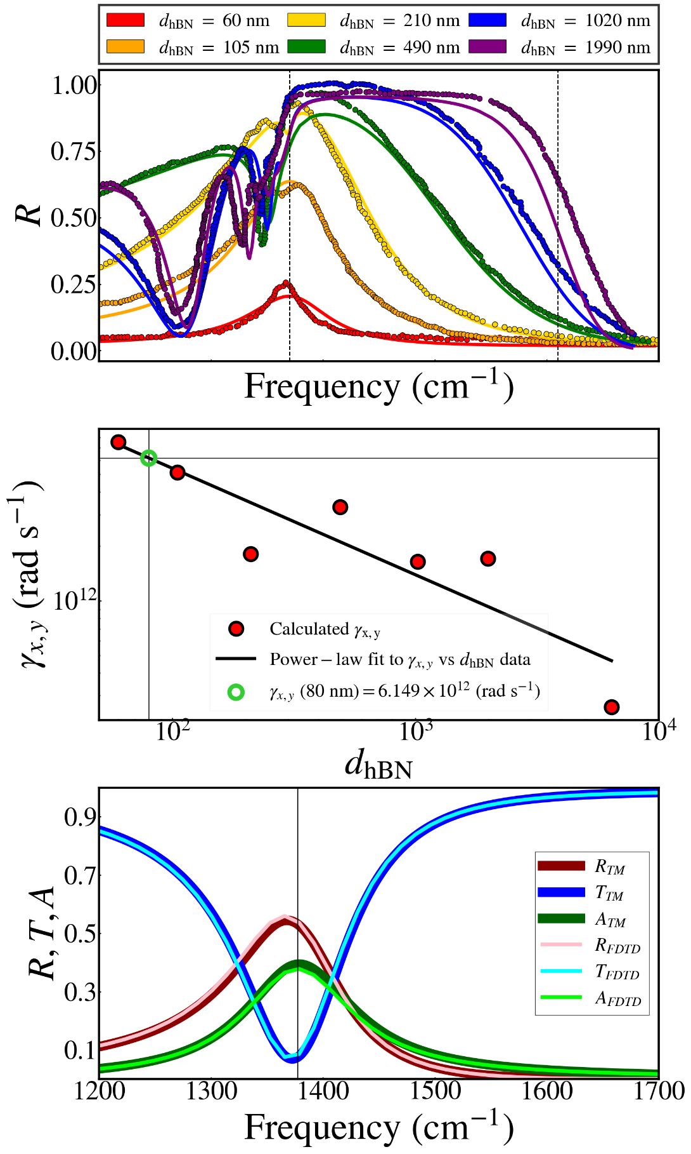
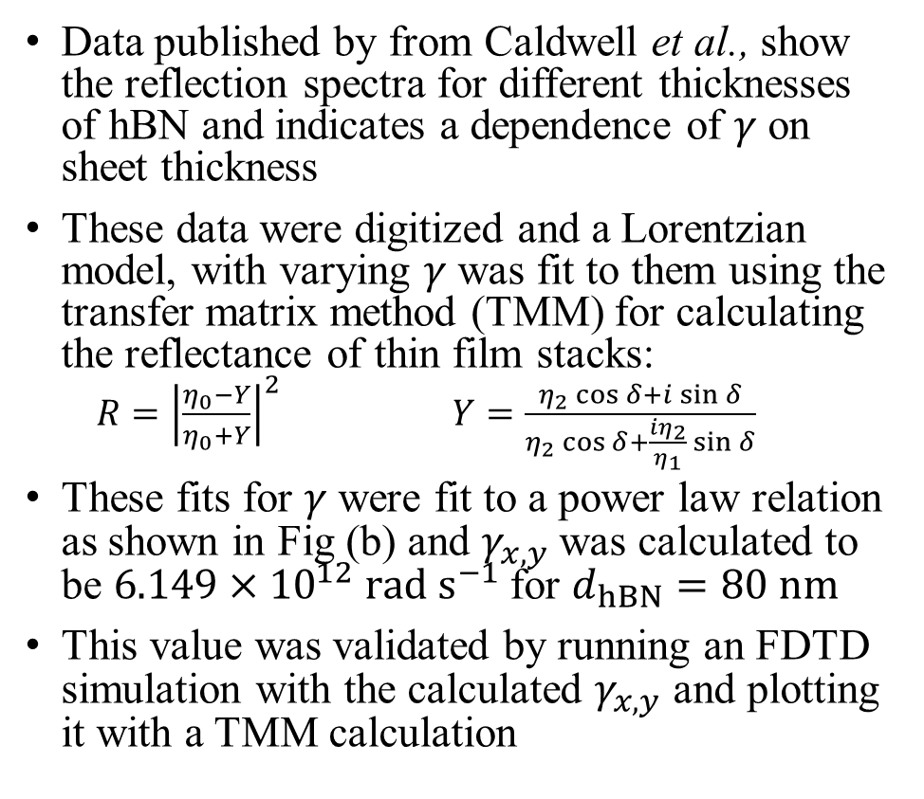
Simulating Materials - hBN - II
Data published by from Caldwell et al., show the reflection spectra for different thicknesses of hBN and indicates a dependence of $γ$ on sheet thickness
These data were digitized and a Lorentzian model, with varying $γ$ was fit to them using the transfer matrix method (TMM) for calculating the reflectance of thin film stacks:
$R={\left|\frac{η_{0}−Y}{η_{0}+Y}\right|}^{2}$ $Y=\frac{η_{2}\cos{δ}+i\sin{δ}}{η_{2}\cos{δ}+\frac{iη_{2}}{η_{1}}\sin{δ}}$
These fits for $γ$ were fit to a power law relation as shown in Fig (b) and $γ_{x,y}$ was calculated to be $6.149×{10}^{12} rad s^{−1}$ for $d_{hBN}=80 nm$
This value was validated by running an FDTD simulation with the calculated $γ_{x,y}$ and plotting it with a TMM calculation
(a)
(b)
(c)

Slide 21


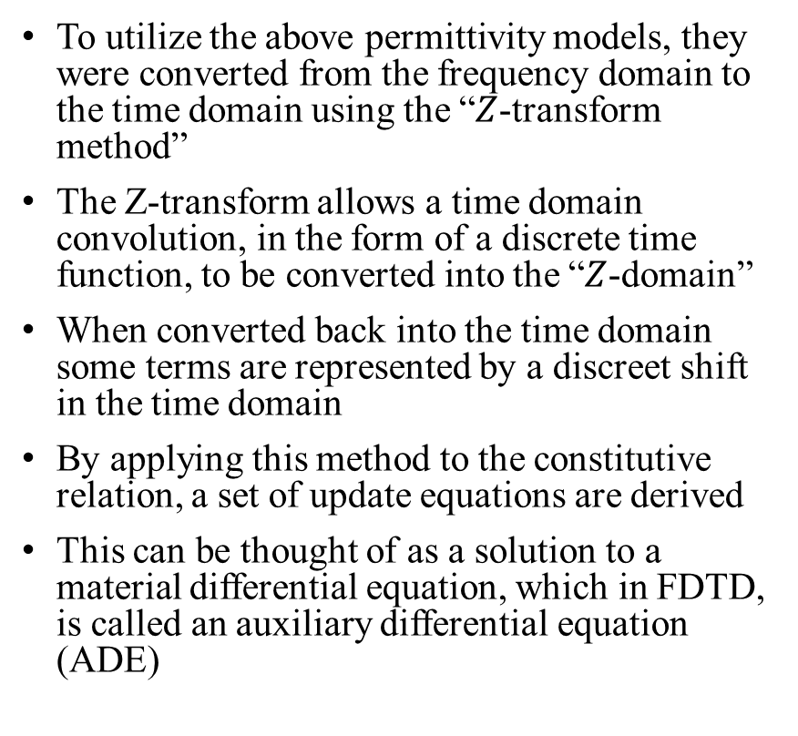
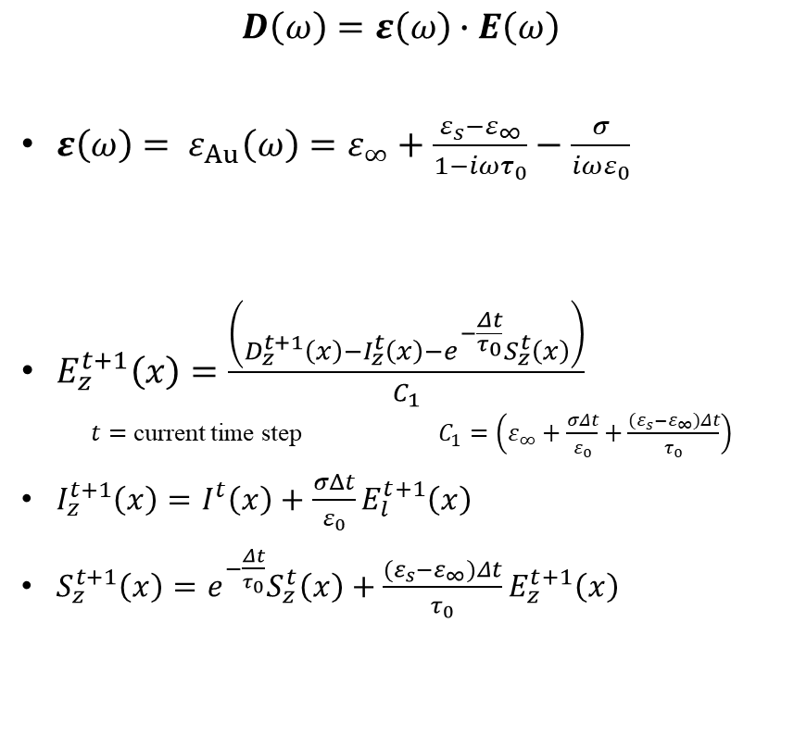
$Z$-Transform Method
constitutive relation
$$D\left(ω\right)=ε\left(ω\right)∙E\left(ω\right)$$
$ε\left(ω\right)= ε_{Au}\left(ω\right)=ε_{∞}+\frac{ε_{s}−ε_{∞}}{1−iωτ_{0}}−\frac{σ}{iωε_{0}}$
$E_{z}^{t+1}\left(x\right)=\frac{\left(D_{z}^{t+1}\left(x\right)−I_{z}^{t}\left(x\right)−e^{−\frac{Δt}{τ_{0}}}S_{z}^{t}\left(x\right)\right)}{C_{1}}$
$t=$ current time step $C_{1}=\left(ε_{∞}+\frac{σΔt}{ε_{0}}+\frac{{(ε}_{s}−ε_{∞})Δt}{τ_{0}}\right)$
$I_{z}^{t+1}\left(x\right)=I^{t}\left(x\right)+\frac{σΔt}{ε_{0}}E_{l}^{t+1}\left(x\right)$
$S_{z}^{t+1}\left(x\right)={e^{−\frac{Δt}{τ_{0}}}S}_{z}^{t}\left(x\right)+\frac{{(ε}_{s}−ε_{∞})Δt}{τ_{0}}E_{z}^{t+1}\left(x\right)$
To utilize the above permittivity models, they were converted from the frequency domain to the time domain using the “$Z$-transform method”
The Z-transform allows a time domain convolution, in the form of a discrete time function, to be converted into the “$Z$-domain”
When converted back into the time domain some terms are represented by a discreet shift in the time domain
By applying this method to the constitutive relation, a set of update equations are derived
This can be thought of as a solution to a material differential equation, which in FDTD, is called an auxiliary differential equation (ADE)
$Z$-transform method

Slide 22


Acceleration
It was decided to write an in-house FDTD code in C and utilizing the OpenACC GPU framework
Using a CPU based commercial code a typical simulation took ~ two weeks
Using a P100 GPU card on the Sapelo2 cluster the in-house code running same simulation could complete in ~ 12 hours
While other FDTD codes using GPUs exist, commercial products could not model all the features needed for this study
Nvidia, 2021

Slide 23
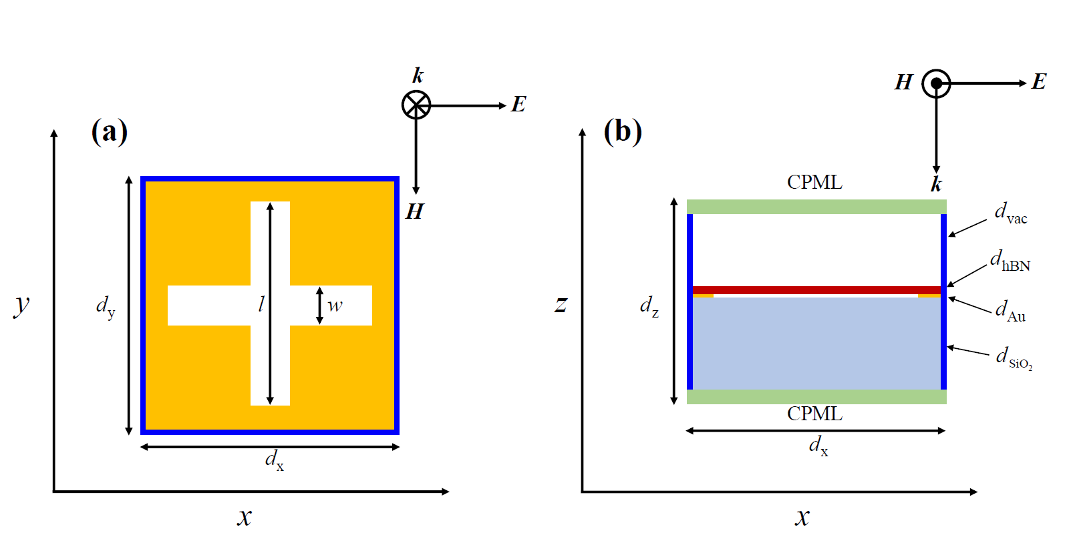
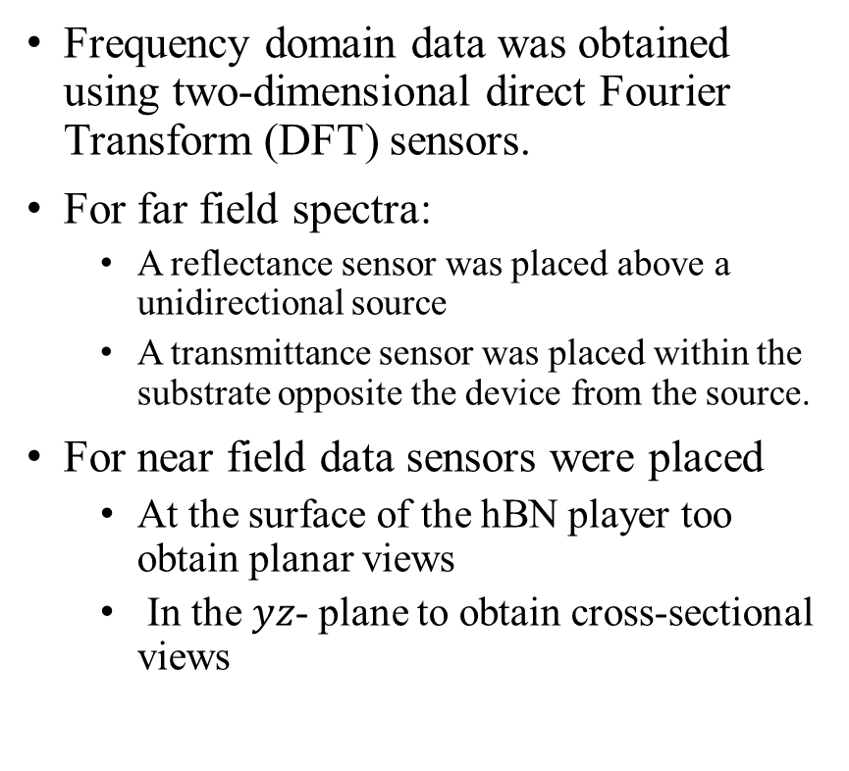
Calculating Spectral Data - I
Frequency domain data was obtained using two-dimensional direct Fourier Transform (DFT) sensors.
For far field spectra:
A reflectance sensor was placed above a unidirectional source
A transmittance sensor was placed within the substrate opposite the device from the source.
For near field data sensors were placed
At the surface of the hBN player too obtain planar views
In the $yz$- plane to obtain cross-sectional views
Reflectance Sensor
Unidirectional source
Spectral cmap sensor
Transmittance Sensor

Slide 24
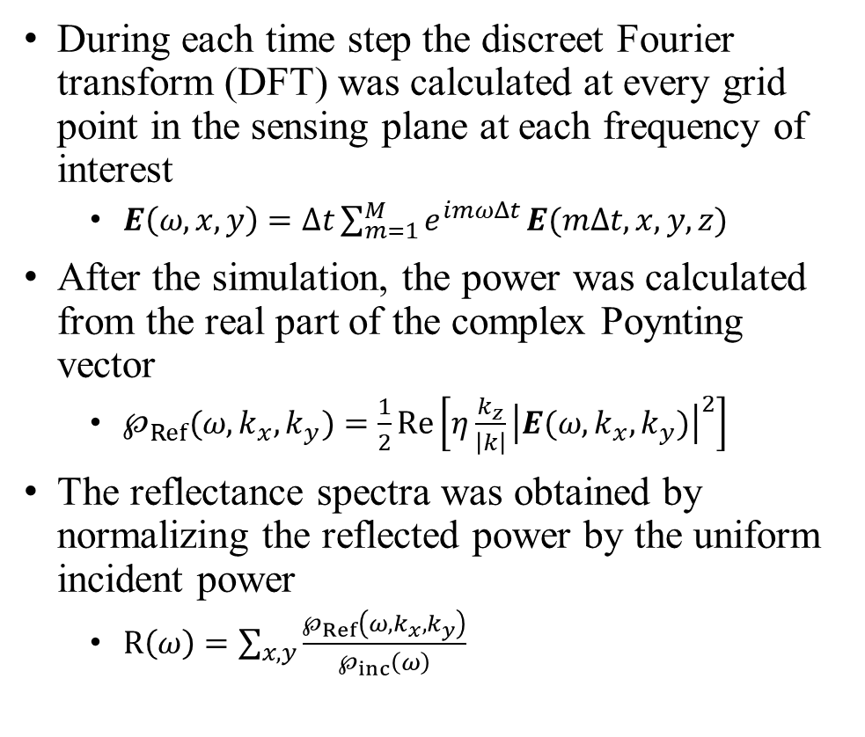
Calculating Spectral Data - II
During each time step the discreet Fourier transform (DFT) was calculated at every grid point in the sensing plane at each frequency of interest
$E\left(ω,x,y\right)=Δt\sum_{m=1}^{M}{e^{imωΔt}}E(mΔt,x,y,z)$
After the simulation, the power was calculated from the real part of the complex Poynting vector
$℘_{Ref}(ω,k_{x},k_{y})=\frac{1}{2}Re\left[η\frac{k_{z}}{\left|k\right|}{\left|E(ω,k_{x},k_{y})\right|}^{2}\right]$
The reflectance spectra was obtained by normalizing the reflected power by the uniform incident power
$R\left(ω\right)=\sum_{x,y}{\frac{℘_{Ref}\left(ω,k_{x},k_{y}\right)}{℘_{inc}\left(ω\right)}}$
Reflectance Sensor
Unidirectional source
Spectral cmap sensor
Transmittance Sensor
Notes:
$M=$ total number of time steps
$m=$ current time step

Slide 25
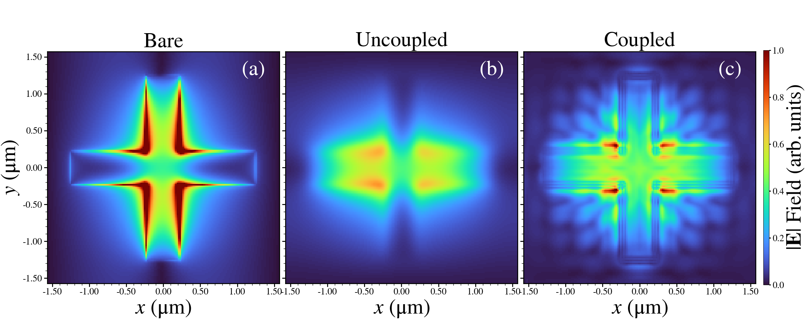
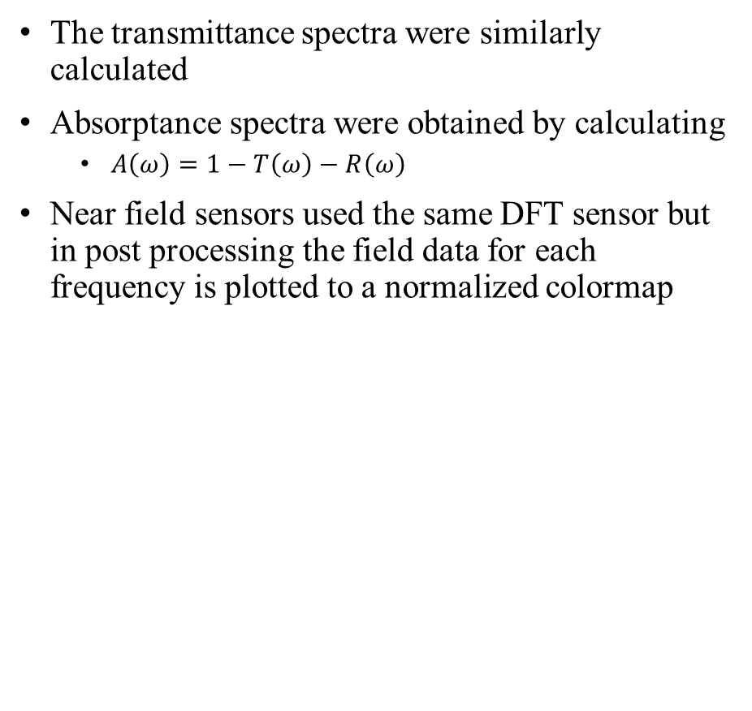
Calculating Spectral Data - III
The transmittance spectra were similarly calculated
Absorptance spectra were obtained by calculating
$A\left(ω\right)=1−T\left(ω\right)−R\left(ω\right)$
Near field sensors used the same DFT sensor but in post processing the field data for each frequency is plotted to a normalized colormap
Reflectance Sensor
Unidirectional source
Spectral cmap sensor
Transmittance Sensor

Slide 26
Outline
Introduction
Motivation
Background
FDTD Methodology
Combined Plasmon-Polariton Phonon-Polariton System
Materials Considerations
Parallelization
First Device Results
Far-field analysis
Near-field analysis
Second Device Comparison
Near-field and far-field
Hexagonal pattern holes in Ag
Third Device Comparison
Near-field and far-field
Perfect Plasmonic Absorber
Conclusions

Slide 27
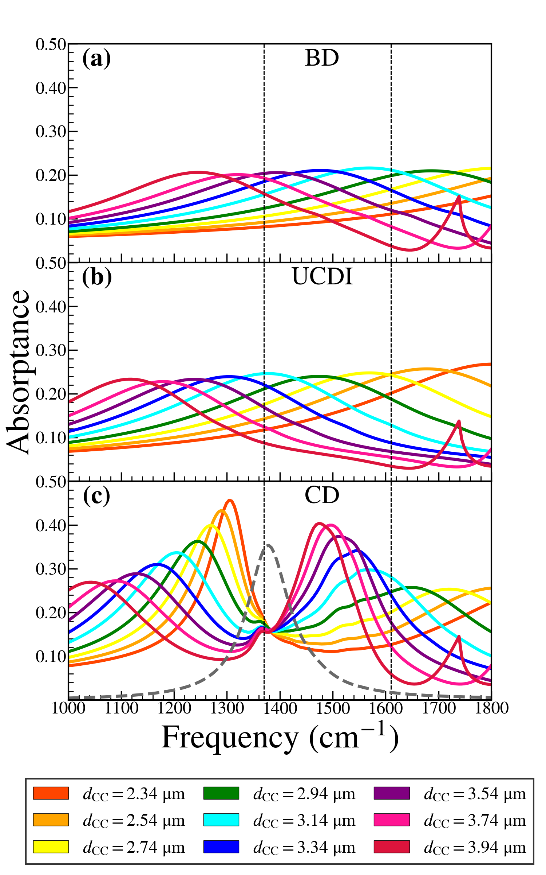




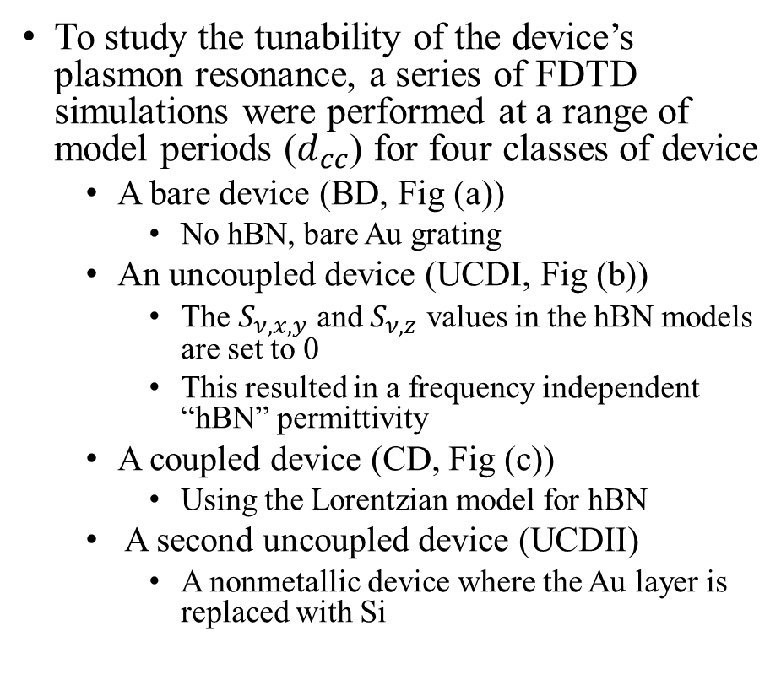
Far Field Analysis - I
TO
LO
To study the tunability of the device’s plasmon resonance, a series of FDTD simulations were performed at a range of model periods ($d_{cc}$) for four classes of device
A bare device (BD, Fig (a))
No hBN, bare Au grating
An uncoupled device (UCDI, Fig (b))
The $S_{ν,x,y}$ and $S_{ν,z}$ values in the hBN models are set to 0
This resulted in a frequency independent “hBN” permittivity
A coupled device (CD, Fig (c))
Using the Lorentzian model for hBN
A second uncoupled device (UCDII)
A nonmetallic device where the Au layer is replaced with Si

Slide 28
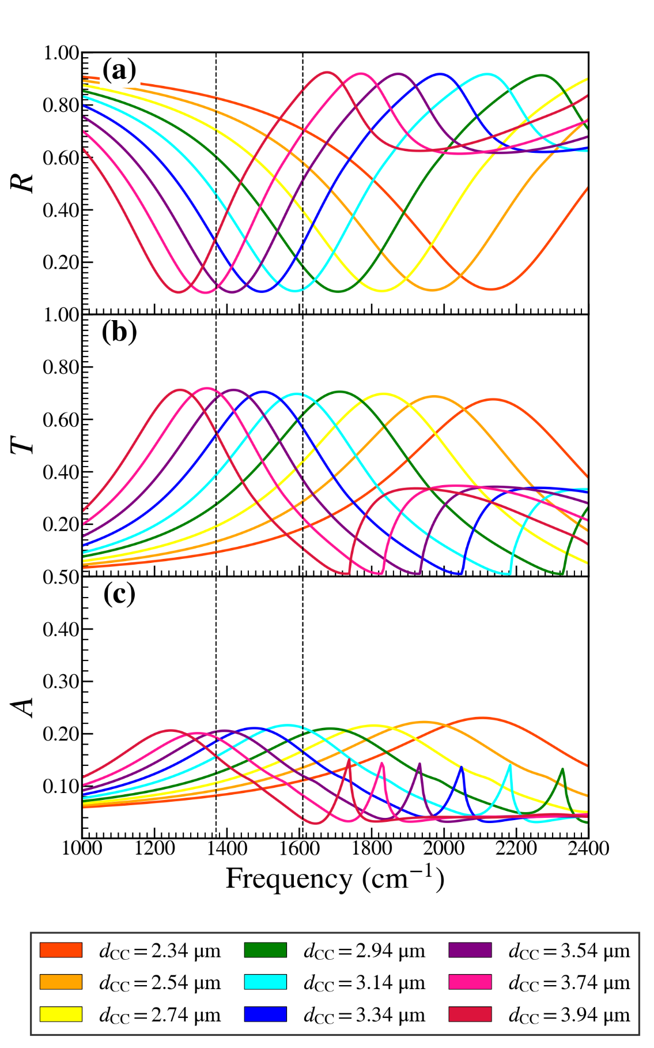
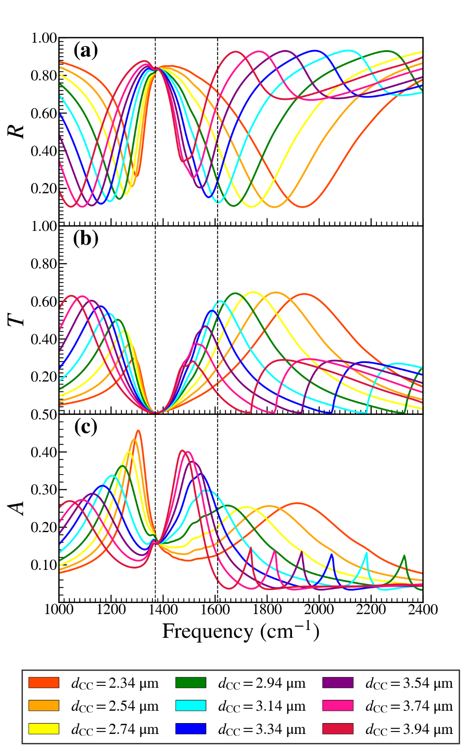
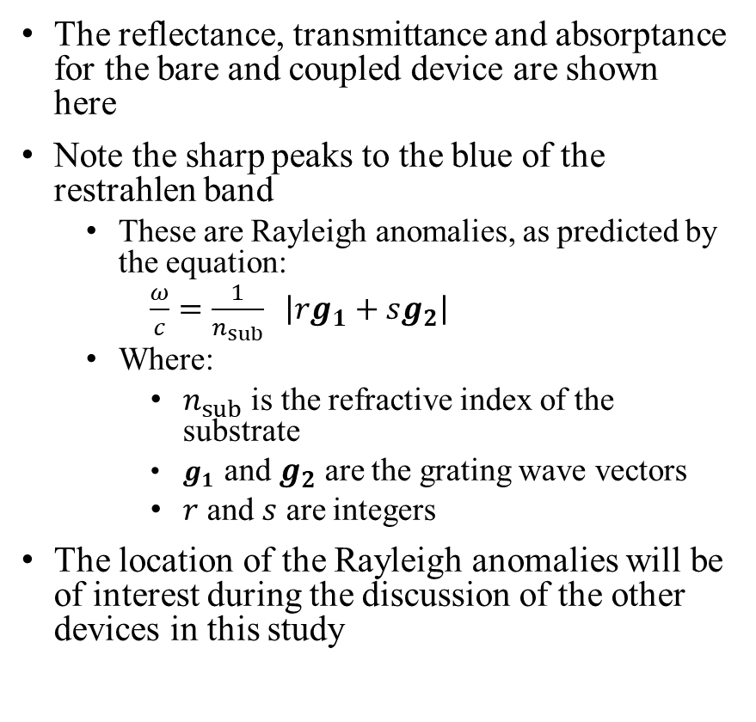
Far Field Analysis - II
BD
CD
The reflectance, transmittance and absorptance for the bare and coupled device are shown here
Note the sharp peaks to the blue of the restrahlen band
These are Rayleigh anomalies, as predicted by the equation:
$\frac{ω}{c}=\frac{1}{n_{sub}} \left|rg_{1}+sg_{2}\right|$
Where:
$n_{sub}$ is the refractive index of the substrate
$g_{1}$ and $g_{2}$ are the grating wave vectors
$r$ and $s$ are integers
The location of the Rayleigh anomalies will be of interest during the discussion of the other devices in this study

Slide 29
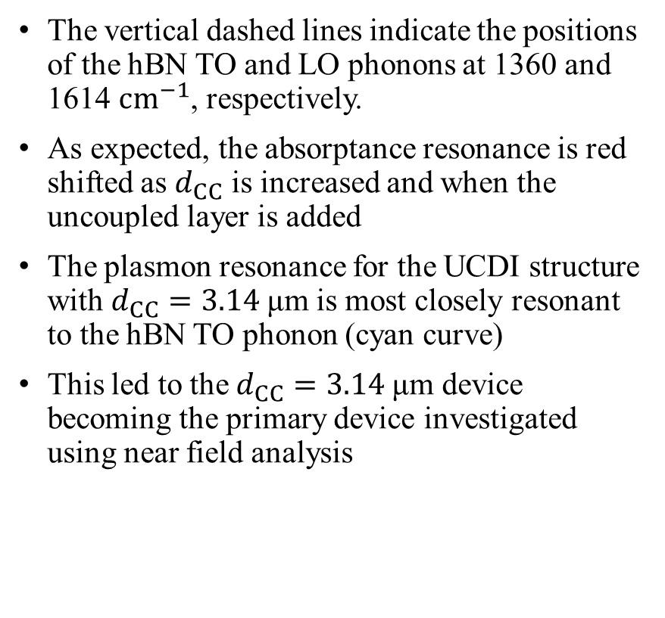
Far Field Analysis - III
TO
LO
The vertical dashed lines indicate the positions of the hBN TO and LO phonons at 1360 and 1614 $cm^{−1}$, respectively.
As expected, the absorptance resonance is red shifted as $d_{CC}$ is increased and when the uncoupled layer is added
The plasmon resonance for the UCDI structure with $d_{CC}=3.14$μm is most closely resonant to the hBN TO phonon (cyan curve)
This led to the $d_{CC}=3.14$μm device becoming the primary device investigated using near field analysis

Slide 30
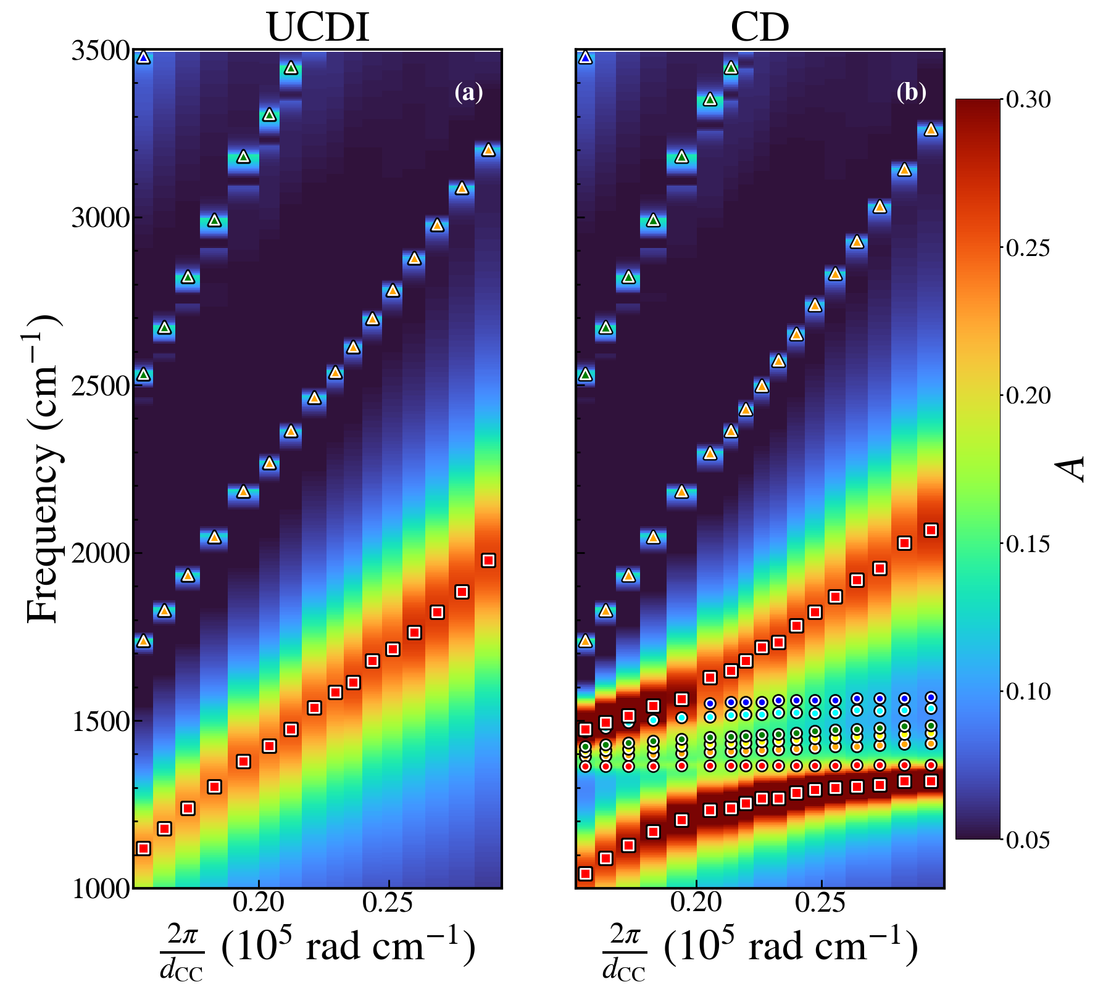
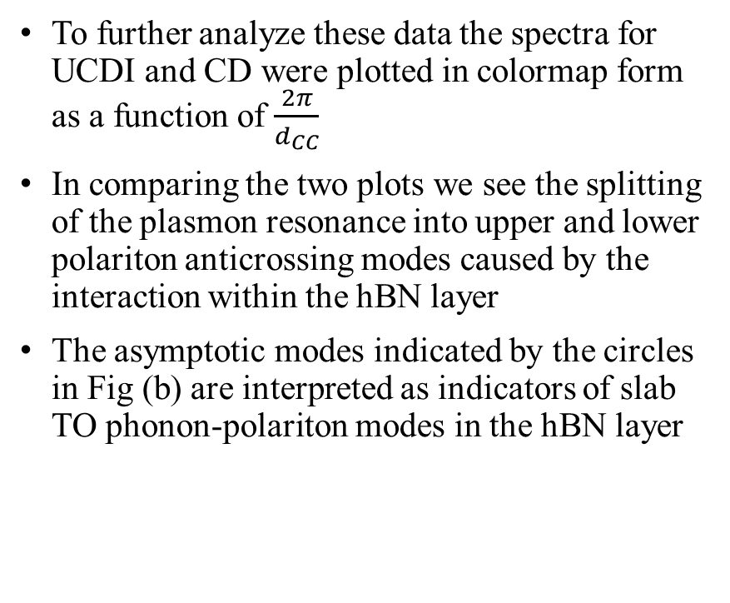
Far Field Analysis - IV
To further analyze these data the spectra for UCDI and CD were plotted in colormap form as a function of $\frac{2π}{d_{CC}}$
In comparing the two plots we see the splitting of the plasmon resonance into upper and lower polariton anticrossing modes caused by the interaction within the hBN layer
The asymptotic modes indicated by the circles in Fig (b) are interpreted as indicators of slab TO phonon-polariton modes in the hBN layer

Slide 31
Outline
Introduction
Motivation
Background
FDTD Methodology
Combined Plasmon-Polariton Phonon-Polariton System
Materials Considerations
Parallelization
First Device Results
Far-field analysis
Near-field analysis
Second Device Comparison
Near-field and far-field
Hexagonal pattern holes in Ag
Third Device Comparison
Near-field and far-field
Perfect Plasmonic Absorber
Conclusions

Slide 32
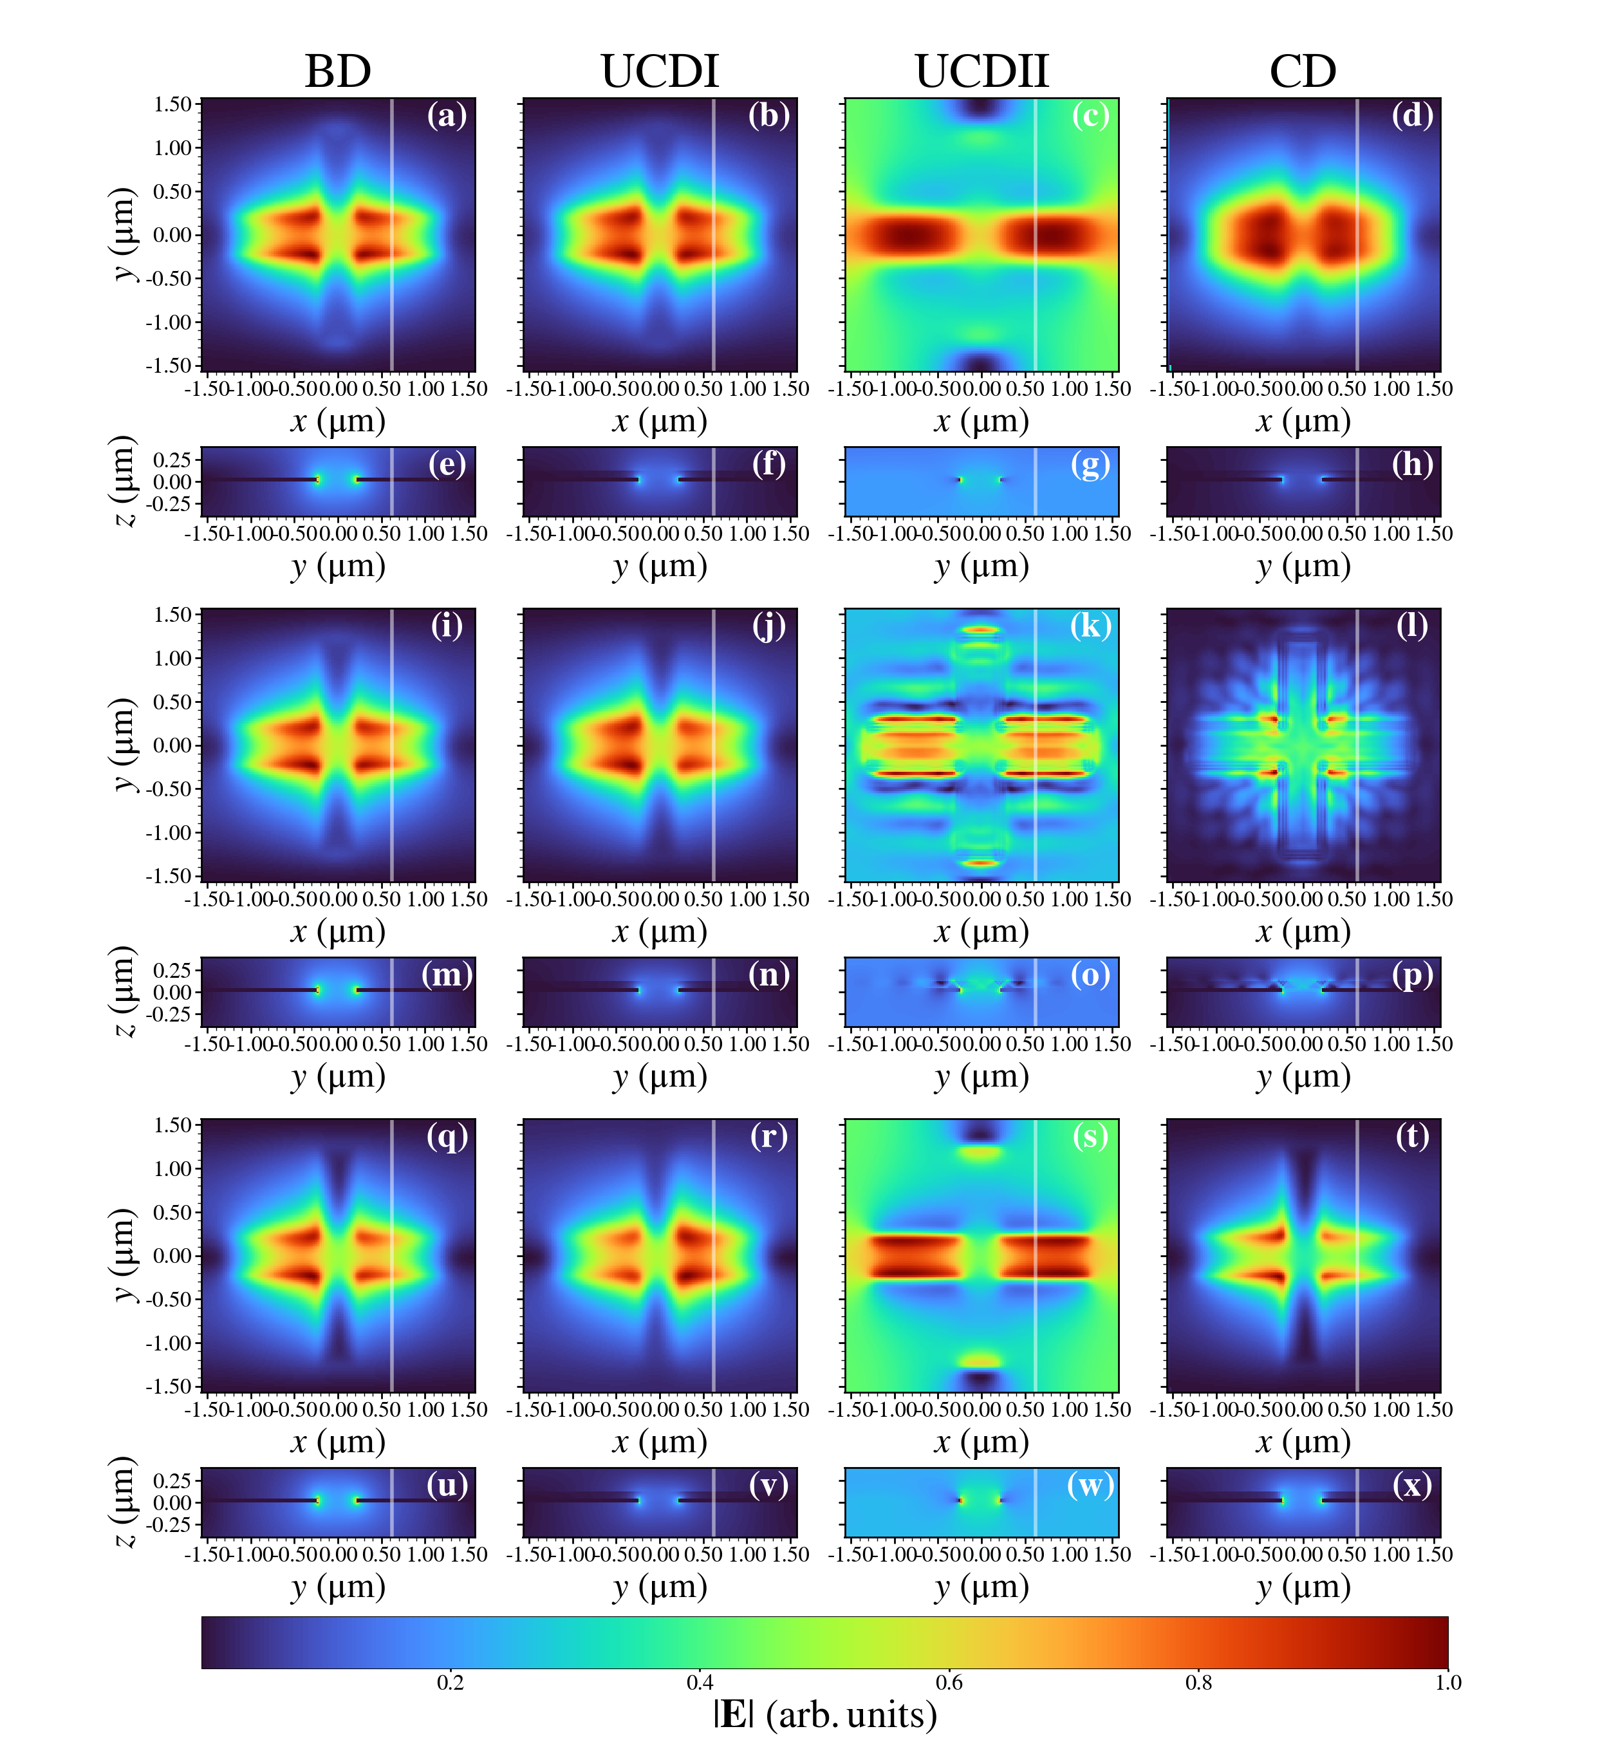
Near Field Analysis - I
Frequency domain electric field distributions are shown in the figure.
Odd rows show the planar view of the hBN surface
Even rows show the cross section taken at the position indicated by the white line in the planar view
Each pane is individually normalized to aid in distinguishing features

Slide 33


Near Field Analysis - II
$$ν=1200 cm^{−1}$$
$$ν=1700 cm^{−1}$$
The data excited above and below the restrahlen band is predominantly plasmonic as expected
The BD, UCDI and CD images display hotspots at the inner corners of the patterned cross due to the metallic grating
These features are smeared in the UCDI and CD due to the presence of the hBN and inert capping layers respectively

Slide 34
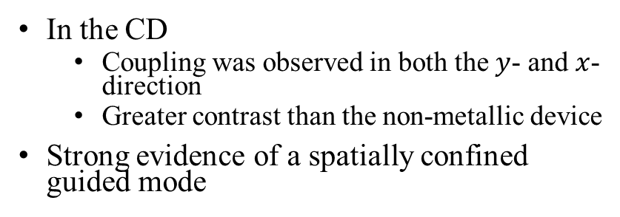
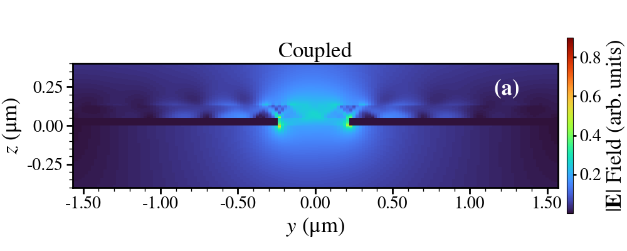


Near Field Analysis - III
Bylinkin et al., 2021
$$ν=1500 cm^{−1}$$
Within the restrahlen band devices without hBN display only plasmonic behavior
In UCDII coupling was only observed parallel to the source
In the CD
Coupling was observed in both the $y$- and $x$-direction
Greater contrast than the non-metallic device
Strong evidence of a spatially confined guided mode

Slide 35
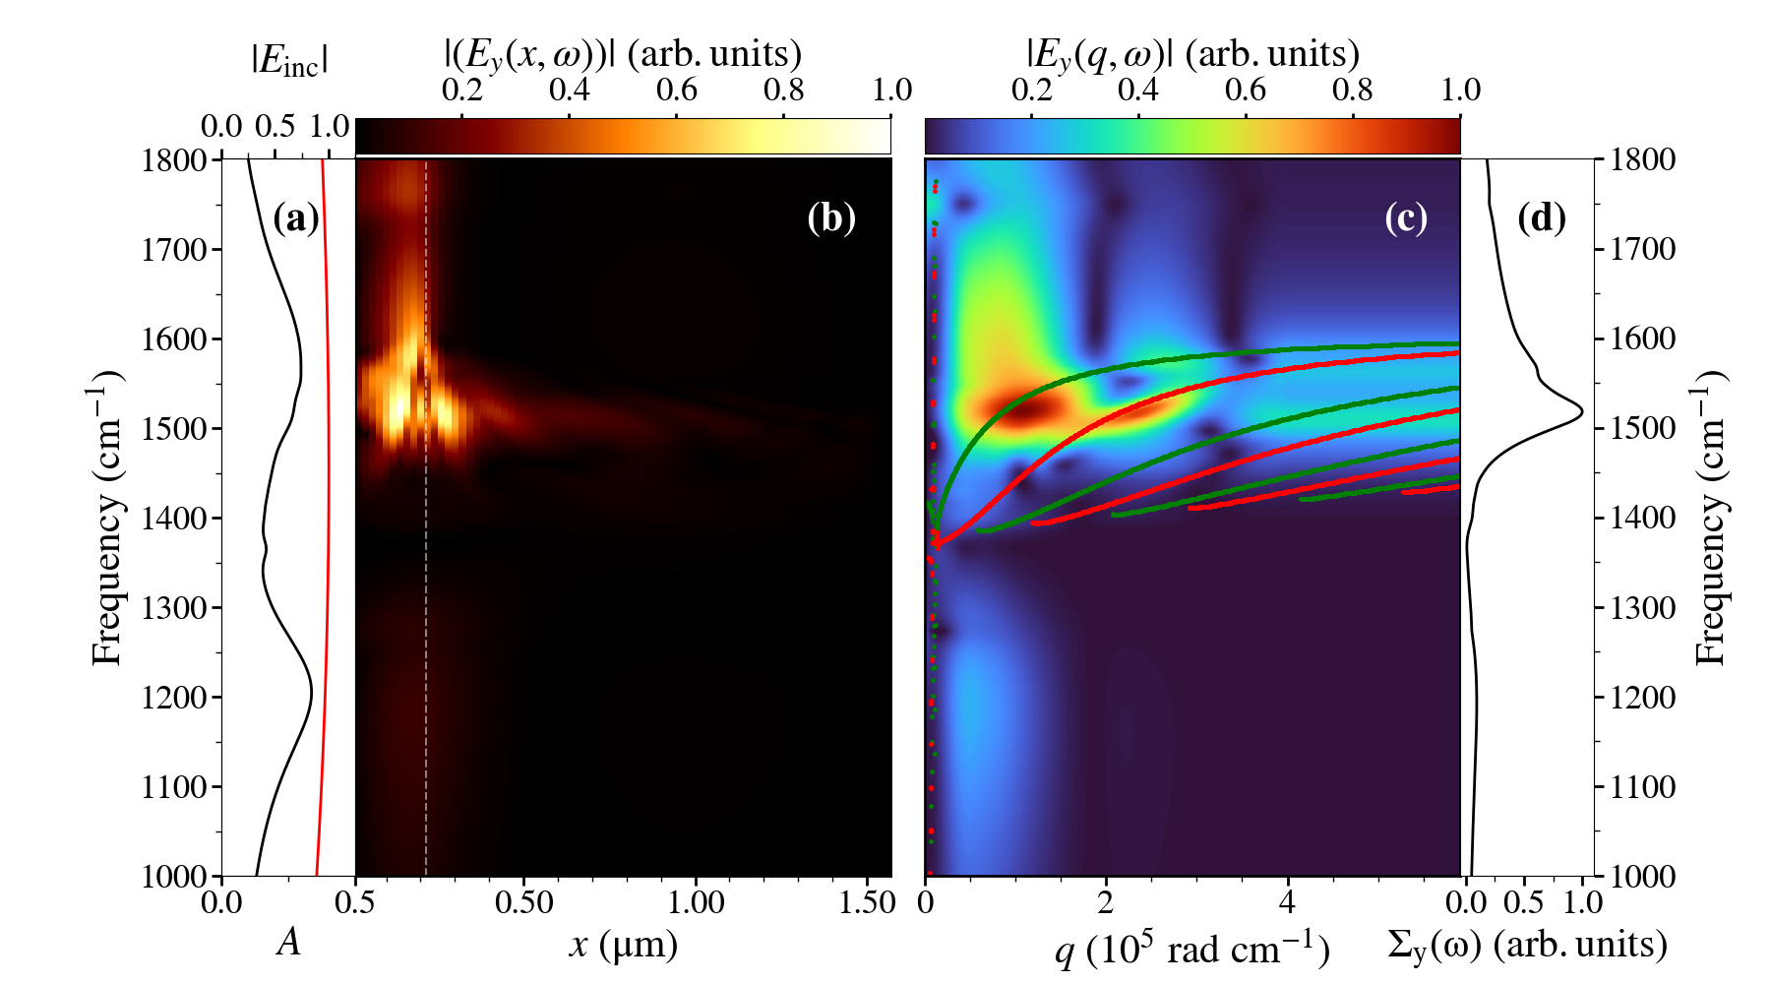
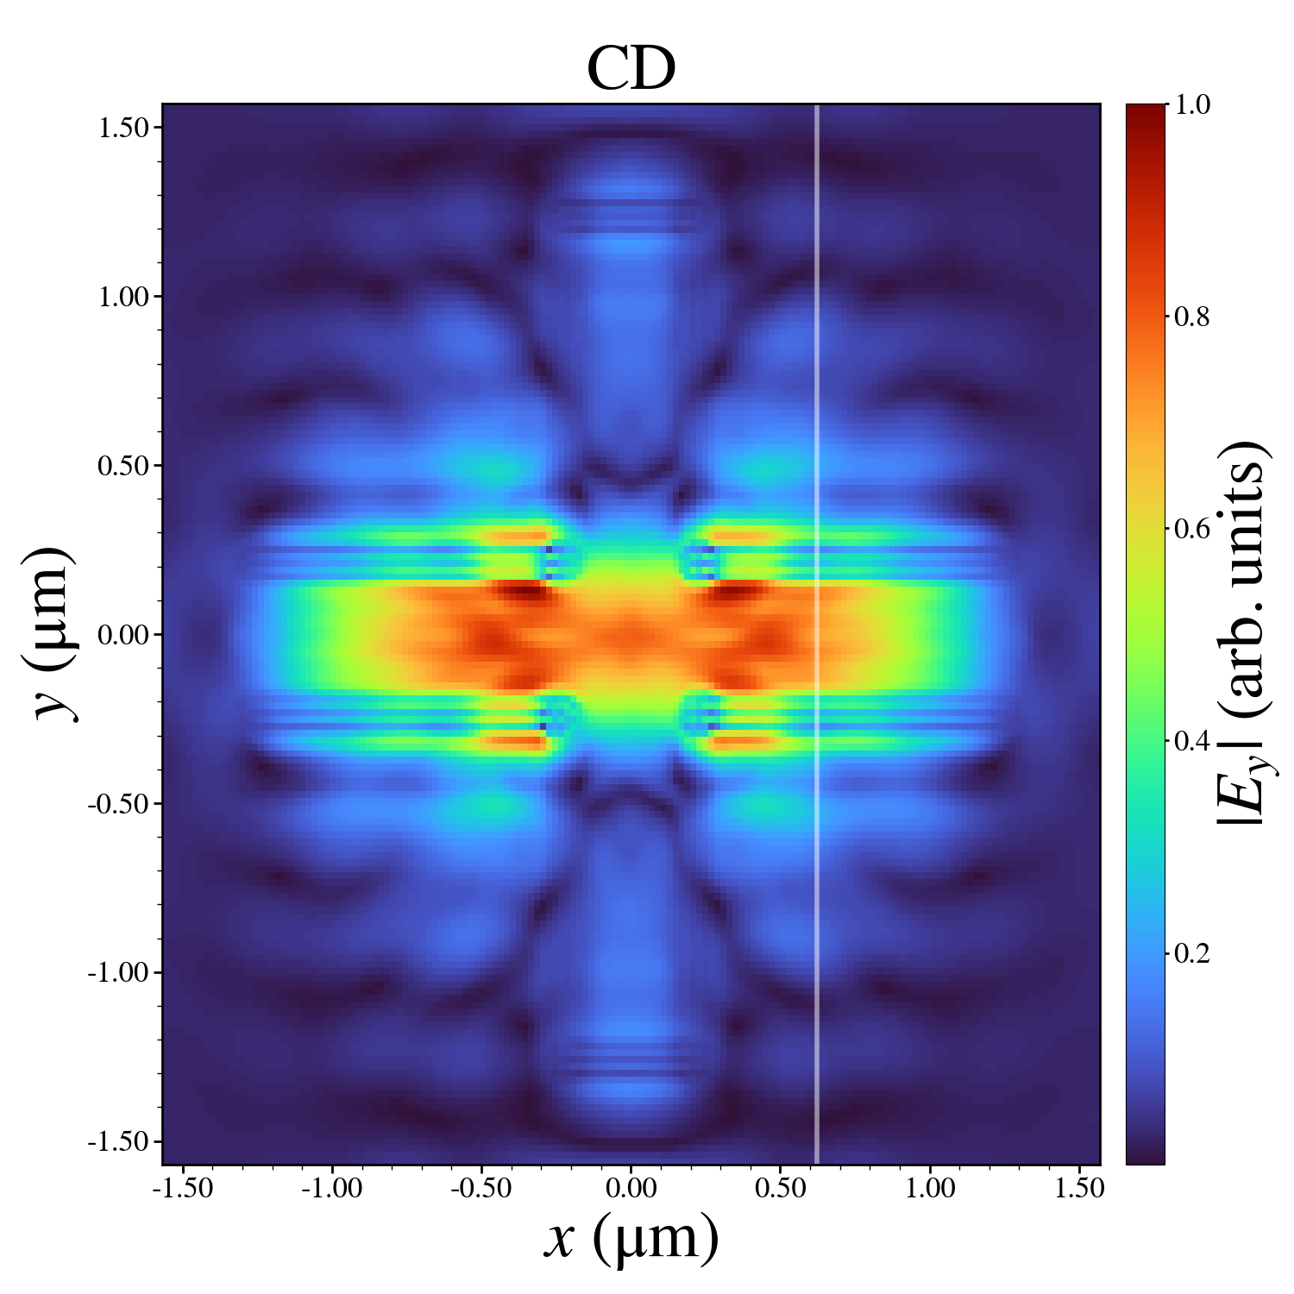
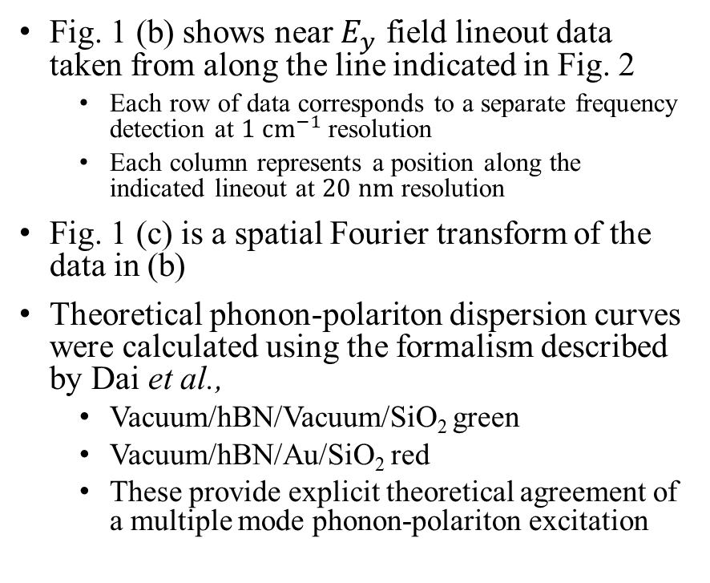
Near Field Analysis - IV
Fig. 1
Fig. 1 (b) shows near $E_{y}$ field lineout data taken from along the line indicated in Fig. 2
Each row of data corresponds to a separate frequency detection at $1 cm^{−1}$ resolution
Each column represents a position along the indicated lineout at $20 nm$ resolution
Fig. 1 (c) is a spatial Fourier transform of the data in (b)
Theoretical phonon-polariton dispersion curves were calculated using the formalism described by Dai et al.,
Vacuum/hBN/Vacuum/SiO₂ green
Vacuum/hBN/Au/SiO₂ red
These provide explicit theoretical agreement of a multiple mode phonon-polariton excitation
Fig. 2

Slide 36


Near Field Analysis - V
Panes (a)-(d) transformed lineouts taken at various frequencies for the devices with:
$d_{CC}=3.14 μm$
panes (a) and (b)
$d_{CC}=3.94 μm$
panes (c) and (d)
Before the Fourier transform a Tukey windowing function was applied to separate signal from
Vacuum/hBN/Vacuum/SiO₂
Pane (a) and (c)
Vacuum/hBN/Au/SiO₂
Pane (b) and (d)
Calculated dispersion curves for these two systems are displayed in green and red for these devices respectively
Similar windowing and dispersion calculations were performed for a range of devices with varying $d_{CC}$

Slide 37

Near Field Analysis - VI
The field strength over these dispersion curves was integrated and shown in the corresponding red and green data sets in pane (e)
These show a dependence on $d_{CC}$ of the phonon- polariton signal strength
Pane (f) shows the integration of the absorptance curves within the limits of the restrahlen band and indicates a similar dependance on $d_{CC}$
The frequency of the peak phonon-polariton signal for different devices are shown in pane (g) as red and green and display a limited spectral tuning with $d_{CC}$
Similar to the plasmon resonance tuning as shown in (h)

Slide 38
Outline
Introduction
Motivation
Background
FDTD Methodology
Combined Plasmon-Polariton Phonon-Polariton System
Materials Considerations
Parallelization
First Device Results
Far-field analysis
Near-field analysis
Second Device Comparison
Near-field and far-field
Hexagonal pattern holes in Ag
Third Device Comparison
Near-field and far-field
Perfect Plasmonic Absorber
Conclusions

Slide 39


Second Device Studied
The second device studied was an 80 nm hBN sheet deposited on a 50 nm Ag film atop a Si substrate
The Ag film was patterned with a hexagonal array of circular shaped apertures with radius
$r_{c}=0. 68 μm$
The step size in the $x$-, $y$- and $z$- dimensions were $20$, $20$ and $2 nm$, respectively
The periodicity was varied between $2.14$ and $2.78 μm$ during the far field analysis of this device

Slide 40

Far Field Analysis - First Device
BD
CD
The reflectance, transmittance and absorptance for the bare and coupled device are shown here for the first device
Note the sharp peaks to the blue of the restrahlen band
These are Rayleigh anomalies, as predicted by the equation:
$\frac{ω}{c}=\frac{1}{n_{sub}} \left|rg_{1}+sg_{2}\right|$

Slide 41



Far Field Analysis - Second Device
BD
CD
The reflectance, transmittance and absorptance for the bare and coupled device are shown here for the second device
Note the sharp troughs in the transmission spectra shown
These are Rayleigh anomalies (RA), as predicted by the equation:
$\frac{ω}{c}=\frac{1}{n_{sub}} \left|rg_{1}+sg_{2}\right|$
The RAs within the restrahlen band are a direct consequence of the Si substrate

Slide 42

Far Field Analysis - Second Device - II
TO
LO
As with the first device tuning of the plasmon resonance is observed
Unlike the plasmon resonances the location of the RAs were independent of the presence of either the coupled or uncoupled hBN layer above the Ag grating
In this way the RAs acted as a sharp “low-pass” filter on the absorption spectra

Slide 43


Far Field Analysis - Second Device - III
To further analyze these data the spectra for UCDI and CD were plotted in colormap form as a function of $\frac{2π}{d_{CC}}$
As with the first device, there was a splitting of the plasmon resonance into upper and lower polariton anticrossing modes caused by the interaction within the hBN layer
Peak positions indicated by red squares were found using the same method as with the first device
RAs, indicated by yellow triangles, were calculated using the equation:
$\frac{ω}{c}=\frac{1}{n_{sub}} \left|rg_{1}+sg_{2}\right|$
This figure illustrates how the presence of RAs limited the utility of far-field analysis methods when studying this device

Slide 44


Near Field Analysis - Second Device
A careful examination of panes (a)-(d) reveals that, unlike the first device, phonon-polaritons for different $d_{CC}$ occured at approximately the same frequency
Panes (e) and (f) show that, like the first device, the variation of the phonon-polariton signal strength is dominated by overlap of the absorptance spectrum with the restrahlen band
Data in pane (g) is too noisy to establish a relation between the phonon-polariton signal peak and $d_{CC}$
Pane (h) shows the low-pass filter effect of the RAs as the trend is overtaken by the linear relation of the RAs with $d_{CC}$ for devices with $d_{CC}<2.30 μm$

Slide 45
Outline
Introduction
Motivation
Background
FDTD Methodology
Combined Plasmon-Polariton Phonon-Polariton System
Materials Considerations
Parallelization
First Device Results
Far-field analysis
Near-field analysis
Second Device Comparison
Near-field and far-field
Hexagonal pattern holes in Ag
Third Device Comparison
Near-field and far-field
Perfect Plasmonic Absorber
Conclusions

Slide 46


Third Device Studied
The device we studied was
An 80 nm thick hBN sheet deposited
Over a 100 nm thick cross shaped Au nanostructure
Over a 196 nm SiO₂ spacer layer
Over a 100 nm thick Au ground sheet
Over a Si substrate
The dimensions of the cross shaped Au nanostructure were
$l=0.8{ d}_{CC}$
$w=0.16 d_{CC}$
Where${ d}_{CC}$is the model periodicity in the $x$- and $y$- dimensions
The step size in the $x$-, $y$- and $z$- dimensions were $20$, $20$ and $2 nm$, respectively

Slide 47
Far Field Analysis - First Device
BD
CD
The reflectance, transmittance and absorptance for the bare and coupled device are shown here for the first device
Note the sharp peaks to the blue of the restrahlen band
These are Rayleigh anomalies, as predicted by the equation:
$\frac{ω}{c}=\frac{1}{n_{sub}} \left|rg_{1}+sg_{2}\right|$

Slide 48



Far Field Analysis - Third Device
BD
CD
The reflectance, transmittance and absorptance for the bare and coupled device are shown here for the third device
Note the lack of Rayleigh anomalies due to the presence of the grounding sheet
Of interest is the transmission spectra are zero for all devices using the perfect absorber structure
For bare devices with $d_{CC}$ in the range $2.46−2.94 μm$ there is 100% absorption in the plasmonic resonance

Slide 49


Far Field Analysis - Third Device - II
TO
LO
Similar to device 1 and 2 a red shift is observed when the inert hBN layer is applied
For the CD
For all $d_{CC}$ strong coupling into a resonance near the TO phonon-polariton mode at 1355 cm⁻¹
Inflections within the restrahlen band which are similar, but more pronounced, to those observed in the first device

Slide 50


Far Field Analysis - Third Device - III
To further analyze these data the spectra for UCDI and CD were plotted in colormap form as a function of $\frac{2π}{d_{CC}}$
As with the first and second device, there was a splitting of the plasmon resonance into upper and lower polariton anticrossing modes caused by the interaction within the hBN layer
Peak positions of the plasmon resonance, indicated by red squares, were found using the same method as with the first device
Of particular interest is the strong behavior near the TO frequency

Slide 51


Near Field Analysis - Third Device - II
Panes (a)-(d) and (g) revealed the phonon-polaritons (on gold) were down shifted in both frequency and wave-vector as$d_{CC}$ increased
Similar to the first device
Dissimilar to the second device
Panes (e) and (f) show that, like the first and second device, the variation of the phonon-polariton signal strength is dominated by overlap of the absorptance spectrum with the restrahlen band
Pane (h) shows the relation between the tuning of the phonon-polariton over vacuum resonance and the plasmon resonance is more closely related than in Device 1

Slide 52

Thank You
Far-Field Analysis
Near-Field Analysis
Device One exhibited smooth Gaussian-like absorption spectra with well separated Rayleigh anomalies
The simplicity of the spectra made the interpretation of data clearer than some of the other device classes
The near-field data from this device provided a framework by which the other device classes could be evaluated
Device two exhibited highly asymmetric absorptance line shapes due to the overlap of the Rayleigh anomalies with the plasmonic absorptance bands
Device three exhibited behavior similar that in the first device but
All devices exhibited zero transmission
Some devices exhibiting perfect absorptance peaks as expected for this geometry
Slab polaritons were identified and categorized by mode number and supporting layer
The transverse magnetic slab phonon-polariton modes in hBN agree with those predicted by theory
Demonstrated both strong confinement in the hBN layer and slow group velocity
The presence of the plasmon-polaritons in the coupled device increases the contrast in the spatial electric field variation
The strength of the phonon-polariton signal varied with$d_{CC}$and that variation is dominated by the spectral overlap of the far-field absorptance spectrum with the restrahlen band
For device 1 and 3 the frequency/wavevector of the phonon-polariton could be tuned by varying $d_{CC}$

Slide 53
Outline
Introduction
Motivation
Background
Methodology
Combined Plasmon-Polariton Phonon-Polariton System
Materials Considerations
Parallelization
First Device Results
Far field analysis
Near field analysis
Second Device Comparison
Third Device Comparison
Conclusions

Slide 54


Conclusions
The hBN layer on a nanopatterned square array of cross apertures in a gold layer exhibited smooth Gaussian-like absorption spectra with well separated Rayleigh anomalies
The simplicity of the spectra made the interpretation of data clearer than some of the other device classes
Consequentially the near-field data from this device provided a framework by which the other device classes could be evaluated

Slide 55

Conclusions
The hBN layer on a nanopatterned hexagonal array of circular apertures in a silver layer exhibited highly asymmetric absorptance line shapes due to the overlap of the Rayleigh anomalies with the plasmonic absorptance bands.

Slide 56

Conclusions
The hBN layer on a nanopatterned square array of gold crosses separated from a ground plane by a dielectric spacer exhibited behavior similar that in the first device but
All devices exhibited zero transmission
Some devices exhibiting perfect absorptance peaks as expected for this geometry.

Slide 57

Conclusions
Investigating the near-field enabled slab polaritons to be identified and categorized by mode number and supporting layer
The transverse magnetic slab phonon-polariton modes in hBN agree with those predicted by theory
These demonstrated both strong confinement to the hBN layer and slow group velocity.
It was shown that the presence of the plasmon –polaritons in the coupled device increases the contrast in the spatial electric field variation
indicating that the plasmon plays a key role in both coupling energy into the hBN phonon-polaritons and in launching phonon-polaritons into different directions within the hBN layer.

Slide 58



Conclusions
For all devices, the strength of the phonon-polariton signal varied with$d_{CC}$and that variation is dominated by the spectral overlap of the far-field absorptance spectrum with the restrahlen band
For device 1 and 2 the frequency/wavevector of the phonon-polariton could be tuned by varying $d_{CC}$

Slide 59
Accomplishments
Technical Accomplishments
Designed an accelerated FDTD simulation
Reduce simulation time from ~ 2 weeks to ~12 hours.
Nvidia, 2021

Slide 60
Accomplishments
Technical Accomplishments
Designed an accelerated FDTD simulation
Reduce simulation time from ~ 2 weeks to ~12 hours.
Implemented far field and near field sensors
Near field sensor output
Far field sensor output

Slide 61

Accomplishments
Technical Accomplishments
(a)
Designed an accelerated FDTD simulation
Reduce simulation time from ~ 2 weeks to ~12 hours.
Implemented far field and near field sensors
Adapted frequency-domain models for use in a time-domain method for:
Anisotropic hBN
Au film
(b)
(c)

Slide 62

Accomplishments
Technical Accomplishments
Designed an accelerated FDTD simulation
Reduce simulation time from ~ 2 weeks to ~12 hours.
Implemented far field and near field sensors
Adapted frequency-domain models for use in a time-domain method for:
Anisotropic hBN
Au film
Designed Linux tools to alter the FDTD code to enable efficient “parameter sweeps”

Slide 63

Accomplishments
Scientific Accomplishments
Investigated excitations in a hBN/nanopatterned Au device
Using far-field analysis
Provided evidence of slab phonon-polaritons in hBN
Detailed the coupling process between plasmon-polaritons in a Au film structure and the plasmon-polaritons

Slide 64
Accomplishments
Scientific Accomplishments
Investigated excitations in a hBN/nanopatterned Au device
Using near field analysis to compare similar devices
Slab phonon-polaritons were identified in the device studied

Slide 65
Accomplishments
Scientific Accomplishments
Investigated excitations in a hBN/nanopatterned Au device
Using near field analysis to compare similar devices
Demonstrated the key role plasmon-polaritons play in
Providing contrast in the spatial electric field
Launching phonon-polaritons into different directions within hBN

Slide 66
Accomplishments
Technical accomplishments
Scientific Accomplishments
Designed an accelerated FDTD simulation
Reduce simulation time from ~ 2 weeks to ~12 hours.
Implemented far field and near field sensors
Adapted frequency-domain models for use in a time-domain method for:
Anisotropic hBN
Au film
Designed Linux tools to alter the FDTD code to enable efficient “parameter sweeps”
Investigated excitations in a hBN/nanopatterned Au device
Using far-field analysis
Provided evidence of slab phonon-polaritons in hBN
Detailed the coupling process between plasmon-polaritons in a Au film structure and the phonon-polaritons
Using near field analysis to compare similar devices
Slab phonon-polaritons were identified and categorized according to mode number
Demonstrated the key role plasmon-polaritons play in
Providing contrast in the spatial electric field
Launching phonon-polaritons into different directions within hBN

Slide 67
Graphene and hBN
In 2014 the Naval Research Laboratory released a report titled: Applications of Graphene Photonics
The potential applications of graphene included in this report include
Broadband photodetection from the UV to the IR
Nanoscale plasmonic metamaterials
Initially hBN was used as a substrate for graphene devices.
Smooth surface, and similar crystal structure, reduced loss
In 2010 it was reported By et al that encapsulating graphene in hBN greatly enhanced electronic transport
(Kumar et al., 2015)
Notes:
Sparking a flurry of investigations into the electric and optoelectric properties of graphene/hBN metamaterials

Slide 68

Plasmons and Polaritons - I
Fig. 1 “Surface Plasmons”, Wikipedia 2021
Fig. 2 Bylinkin et al., 2021
Surface plasmons(SPs) are coherent delocalized electron oscillations that exist at the interface between any two materials where the real part of the dielectric function changes sign across the interface (e.g. a metal-dielectric interface, such as a metal sheet in air).
A localized surface plasmon(LSP) is the result of the confinement of a surface plasmon in a nanoparticle of size comparable to or smaller than the wavelength of light used to excite the plasmon.
Surface plasmon polaritons(SPPs) are electromagnetic waves that travel along a metal–dielectric or metal–air interface, practically in the infrared or visible-frequency. The term "surface plasmon polariton" explains that the wave involves both charge motion in the metal ("surface plasmon") and electromagnetic waves in the air or dielectric ("polariton").
In physics, a phonon is a collective excitation in a periodic, elastic arrangement of atoms or molecules in condensed matter, specifically in solids and some liquids.
In physics, polaritons are quasiparticles resulting from strong coupling of electromagnetic waves with an electric or magnetic dipole-carrying excitation.
Phonon polaritons result from coupling of an infrared photon with an optical phonon.
---Definitions From Wikipedia

Slide 69

Drude Debye $Z$-Transform
Ez[n,x]=(Dz[n,x]-Iz[n-1,x]
-exp(-dt/tau)Sz[n-1,x])/C
Iz[n,x]=Iz[n-1,x] +(sig*dt/eps0)*Ez[n,x]
Sz[n,x]=exp(-dt/tau)*Sz[n-1,x]
+dt*(epss-eps_inf)*Ez[n,x]/tau

Slide 70

$R={\left|\frac{η_{0}−Y}{η_{0}+Y}\right|}^{2}$ $Y=\frac{η_{2}\cos{δ}+i\sin{δ}}{η_{2}\cos{δ}+\frac{iη_{2}}{η_{1}}\sin{δ}}$
$η_{1}=η_{0}\sqrt{ε_{hBN}(ω)}$ $δ=\frac{ωd}{c_{0}}\sqrt{ε_{hBN}(ω)}\cos{θ}$
$η_{0}=$ optical admittance $η_{2}=η_{0}η_{b}$ of free-space
$η_{b}=$ optical admittance $c_{0}=$ speed of light of the substrate in vacuum

Slide 71

Calculating Spectral Data - II
During each time step the discreet Fourier transform (DFT) was calculated at every grid point in the sensing plane at each frequency of interest
$E\left(ω,x,y\right)=Δt\sum_{m=1}^{M}{e^{imωΔt}}E(mΔt,x,y,z)$
$M=$ total number of time steps
$m=$ current time step
After the simulation, the power was calculated from the real part of the complex Poynting vector
$℘_{Ref}(ω,k_{x},k_{y})=\frac{1}{2}Re\left[η\frac{k_{z}}{\left|k\right|}{\left|E(ω,k_{x},k_{y})\right|}^{2}\right]$
$k$ is the wave vector
$η$ is the admittance of the medium containing the sensor
The reflectance spectra was obtained by normalizing the reflected power by the uniform incident power
$R\left(ω\right)=\sum_{x,y}{\frac{℘_{Ref}\left(ω,k_{x},k_{y}\right)}{℘_{inc}\left(ω\right)}}$
Reflectance Sensor
Unidirectional source
Spectral cmap sensor
Transmittance Sensor

Slide 72






Computational Cost
The FDTD method allows space to be represented as two interpenetrating grids
Time is advanced by solving magnetic field value at each point in the grid then repeating the process for the electric field.
This is a computationally time-consuming process using conventional computing methods
$$H_{x}$$
$$H_{x}$$
$$H_{x}$$
$$H_{y}$$
$$E_{z}$$
$$H_{y}$$
$$E_{z}$$
$$H_{y}$$
$$E_{z}$$
$$E_{y}$$
$$E_{y}$$
$$E_{y}$$
$$E_{x}$$
$$E_{x}$$
$$E_{x}$$
$$H_{z}$$
$$H_{z}$$
$$H_{z}$$
$$H_{x}$$
$$H_{x}$$
$$H_{x}$$
$$H_{y}$$
$$E_{z}$$
$$H_{y}$$
$$E_{z}$$
$$H_{y}$$
$$E_{z}$$
$$E_{y}$$
$$E_{y}$$
$$E_{y}$$
$$E_{x}$$
$$E_{x}$$
$$E_{x}$$
$$H_{z}$$
$$H_{z}$$
$$H_{z}$$

Slide 73
Sequential (CPU) Programming
A conventional CPU based simulation will step through each cell in the order they are labeled.
The processor can only solve one cell component at a time.

Slide 74
Parallelization (GPU Programing)
However, the order the cells are calculated within each time step don’t matter
A parallelized code will submit a calculation to the processing unit core as soon as it is available
This is done independent of the state of the other calculations in the loop

Slide 75

Acceleration
All simulation data in this study was done using the resources provided by the Georgia Advanced Computing Research Center (GACRC)
It is possible to use modern CPU technology to provide extensive parallelization at significant cost
Commercial code was run on a 48 core Intel Xeon Broadwell processor on the GACRC’s high performance computing cluster
Typical simulation size of
$115×200×1000$ cells
Running $1×{10}^{6}$ time steps
Required ~two weeks

Slide 76


Near Field Analysis - II
$$ν=1200 cm^{−1}$$
The data excited above and below the restrahlen band is predominantly plasmonic as expected
The BD, UCDI and CD images display hotspots at the inner corners of the patterned cross that UCDII does not
This is due to the metallic corners created by the Au pattern
These features are smeared in the UCDI and CD due to the presence of the hBN and inert capping layers respectively
$$ν=1700 cm^{−1}$$

Slide 77






Compute $∇×E$
yes
Inject TF/SF Source into $∇×E$
Write output data to file
$$t<Max Time$$
no
Update $H$ Grid
Compute $∇×H$
Inject counter TF/SF Source into $∇×H$

Slide 78










Main FDTD Loop
Compute $∇×E$
yes
Record Time Sensor Arrays
$$t<Max Time$$
Inject TF/SF Source into $∇×E$
Update $E$ Grid
Update DFT Calculations
no
Update $D$ Field PML
Update $H$ Grid
Update $H$ Field PML
Write Output Data to Files
Update $D$ Grid
Inject counter TF/SF Source into $∇×H$
Compute $∇×H$

Slide 79
Initialize the Grid
Read in Parameters
Allocate Memory for All Field Arrays
Define PML Parameter Values
Write Structure Data to Files
Assign Dielectric Model and Parameter Values
Return to Main

Slide 80
Main FDTD Code Flow
Define Parameters in Header File
Initialize Output Files
Initialize the Grid
Allocate FDTD Arrays to the GPU
Main FDTD Update Loop
Write Output Data to Files

